Slide 1
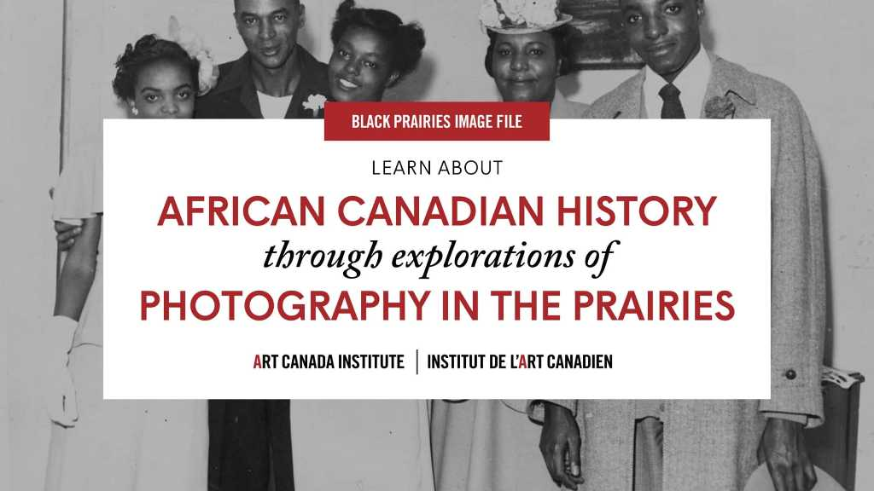

Slide 2
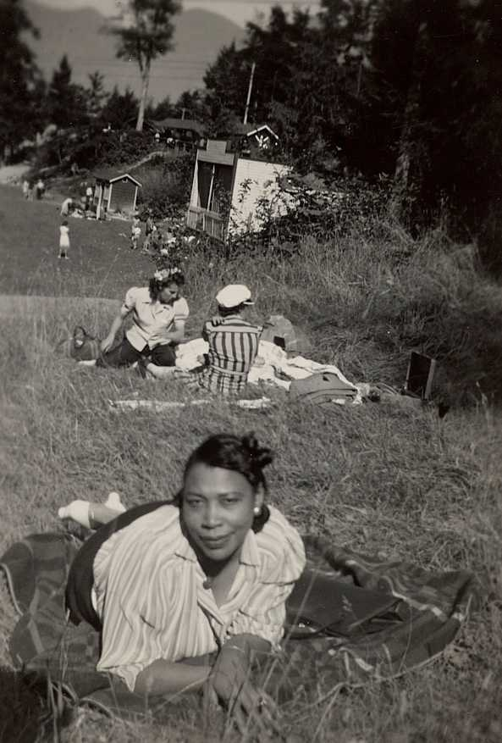
Mary Fair, 1940. This portrait is part of a collection of vernacular photographs donated by Frank B. Jamerson to the City of Edmonton Archives.

Slide 3
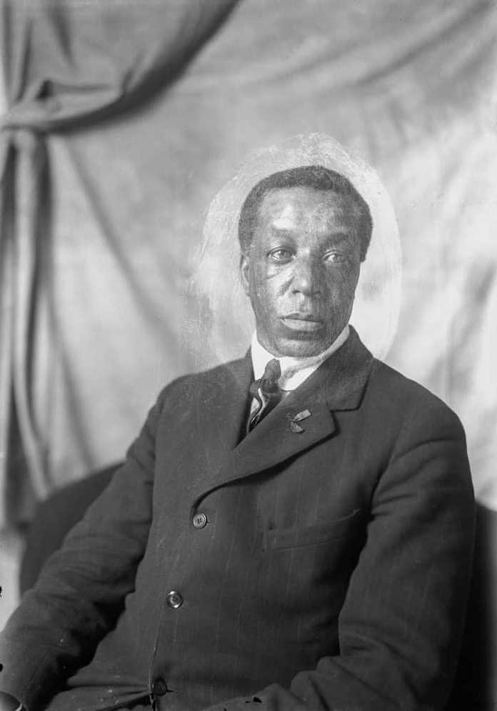
William S. A. Beal, Self-Portrait, c.1918.

Slide 4
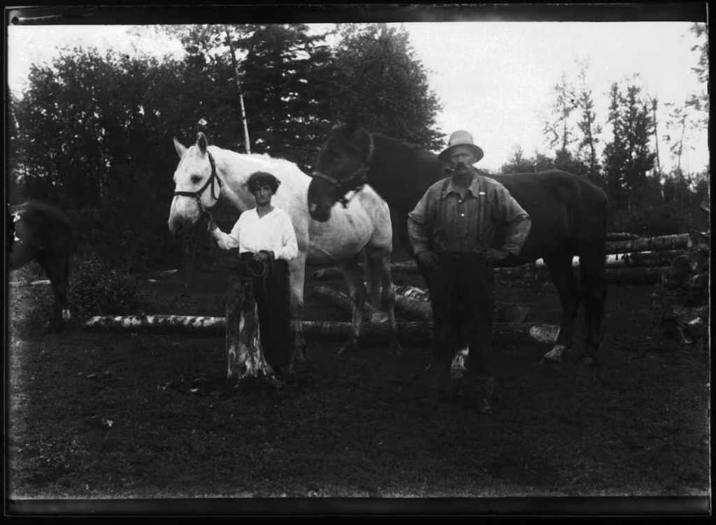
William S. A. Beal, Gus and Louie Jonsson skidding logs on their homestead with their horses, Grey and Jim, Big Woody district, Swan River Manitoba, c.1916.

Slide 5
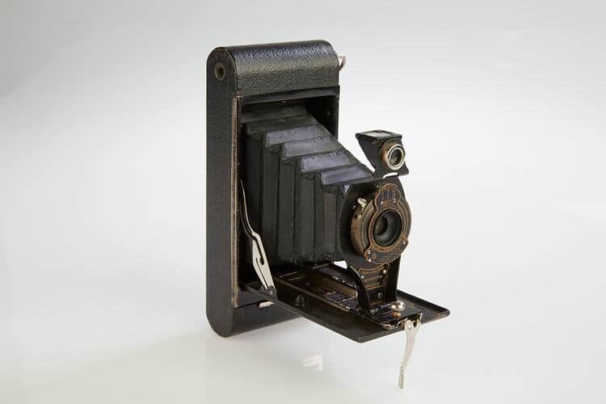
Folding Box Camera, 1915–23. This is an example of what camera technology looked like in the early twentieth century.

Slide 6
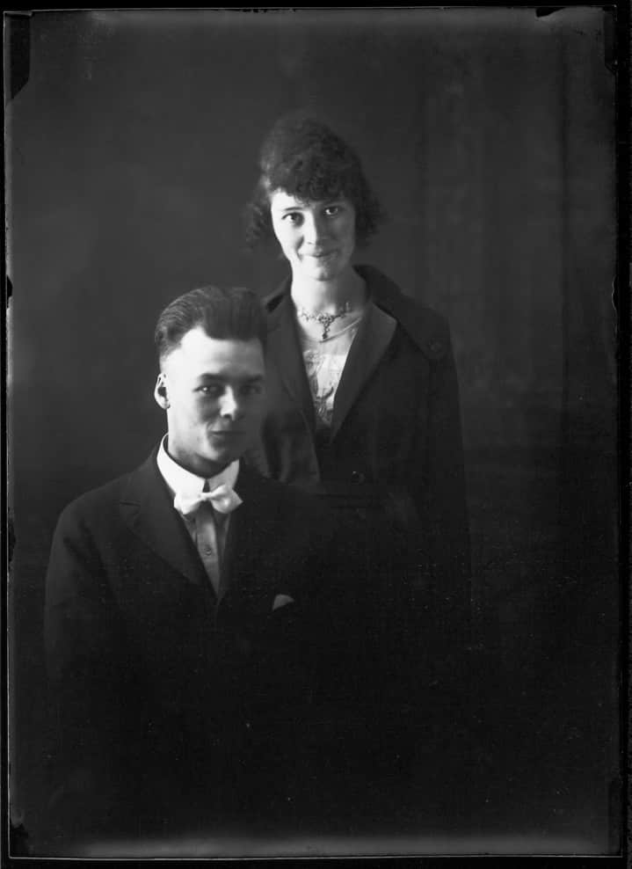
William S. A. Beal, Unidentified man and woman, probably Big Woody district, Swan River, Manitoba, c.1918.

Slide 7
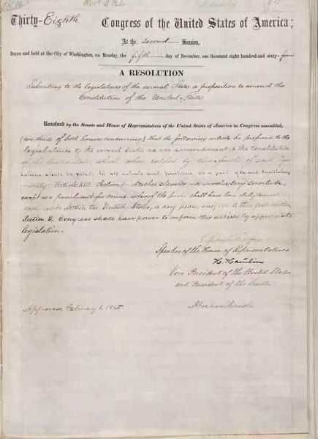
13th Amendment to the U.S. Constitution: Abolition of Slavery, January 31, 1865.

Slide 8
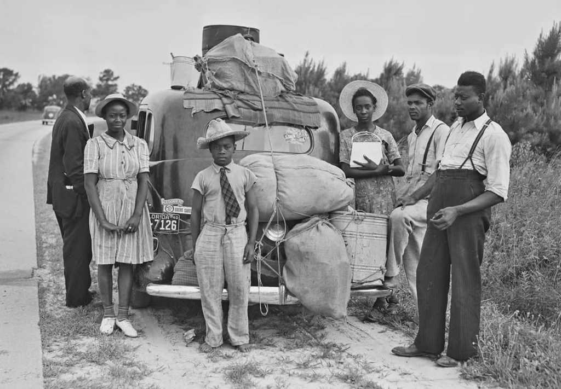
An African American family leaves North Carolina for New Jersey, c.1940.

Slide 9
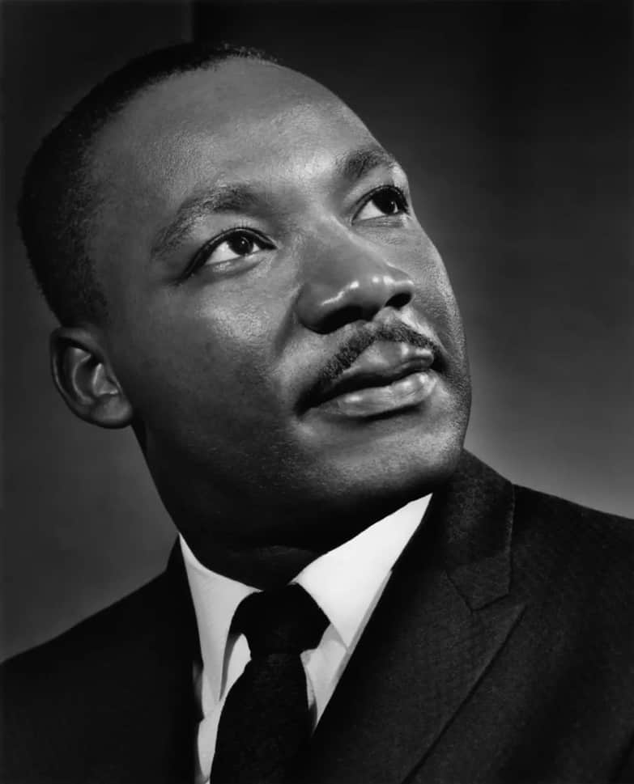
Yousuf Karsh, Dr. Martin Luther King Jr., 1962. Dr. King was the most prominent leader of the American Civil Rights movement.

Slide 10
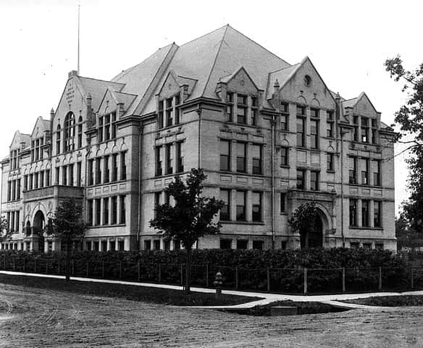
North Community High School, Minneapolis, Minnesota, 1914–73. Beal attended the school in the 1890s.

Slide 11
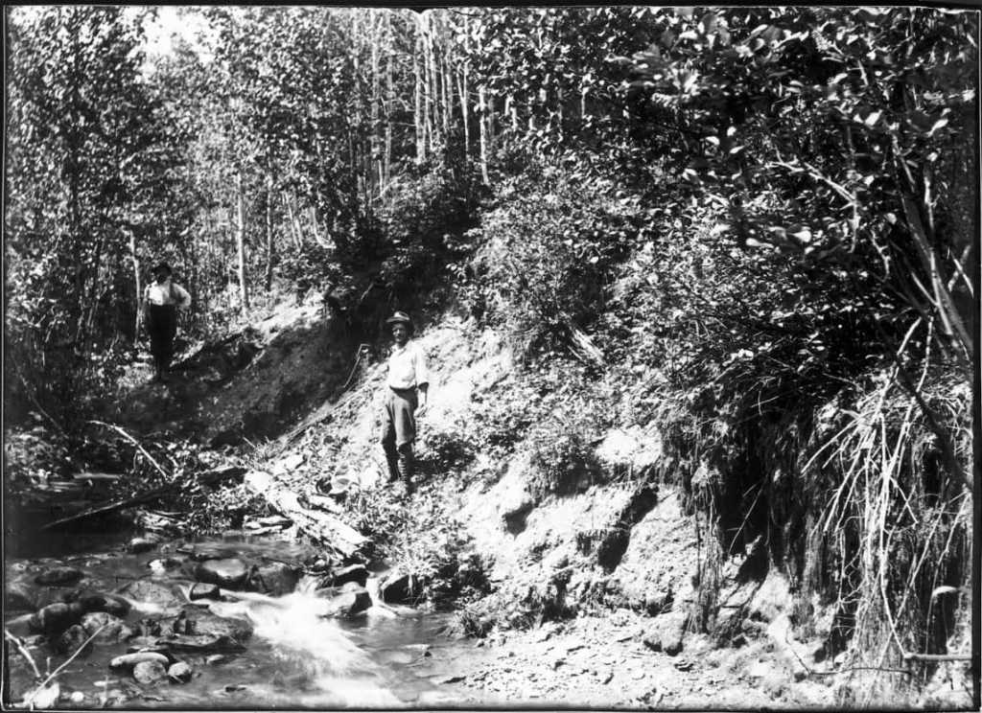
William S. A. Beal, Untitled, twentieth century. This image likely pictures Big Woody District in Manitoba’s Swan River Valley.

Slide 12
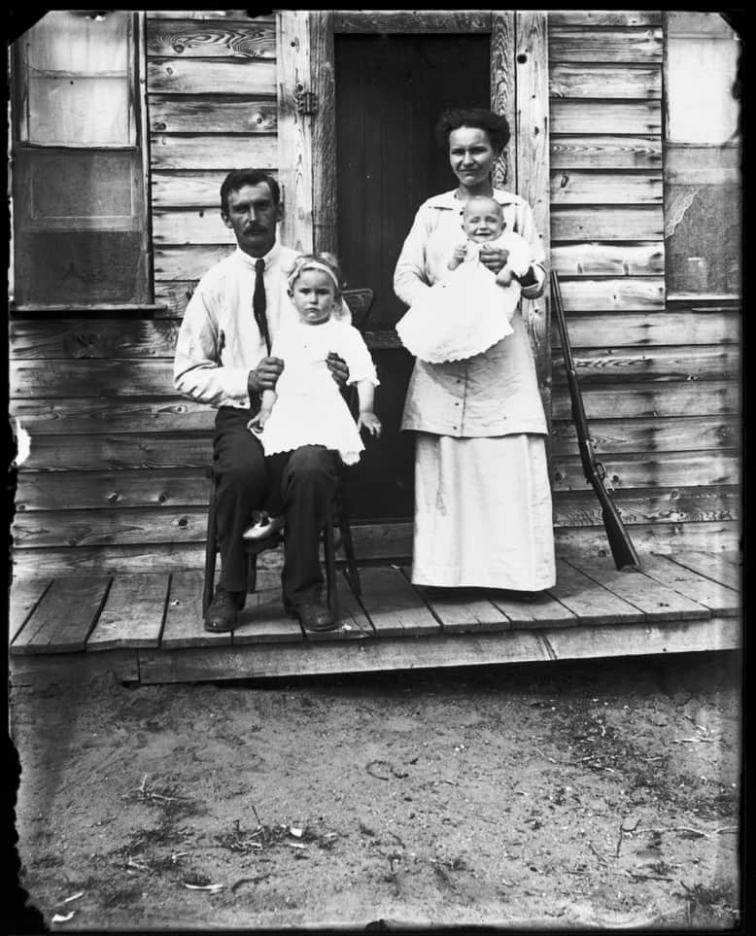
William S. A. Beal, Percy and Emma Potten with children, Evelyn and Bert, 1915. This is an example of one of Beal’s skilled family portraits.

Slide 13
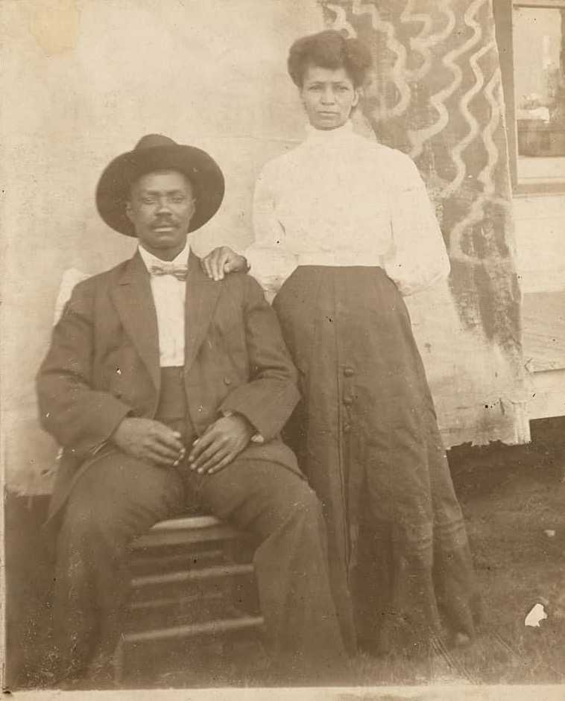
Mr. and Mrs. Spriggs of Begg, Oklahoma, n.d. This domestic portrait reflects how photography preserved memory and community ties.

Slide 14
Mary Wagner, 1927. Wagner is seen here posing stoically against a snow-covered backdrop.

Slide 15
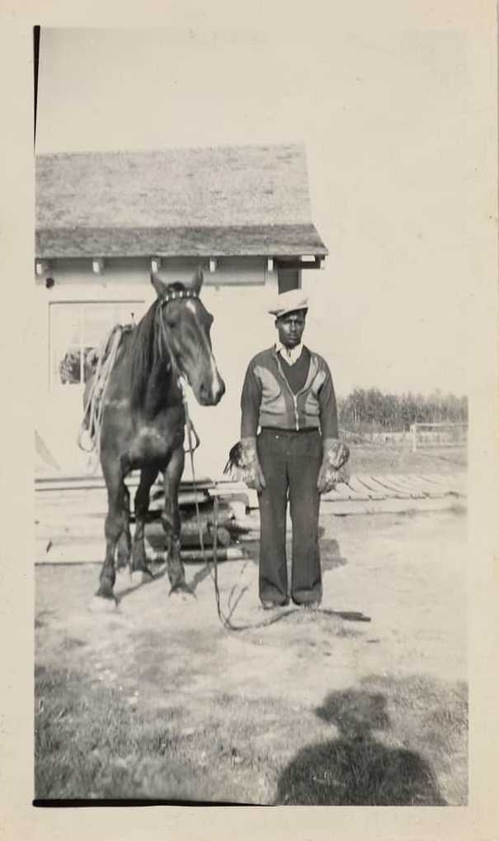
Amber Valley Farmer, n.d. The area of Alberta depicted here was settled by Black homesteaders in the early twentieth century.

Slide 16
Rosa and Mary, n.d. Rosa and Mary confidently pose for the camera, suggesting a degree of familiarity with the photographer.

Slide 17
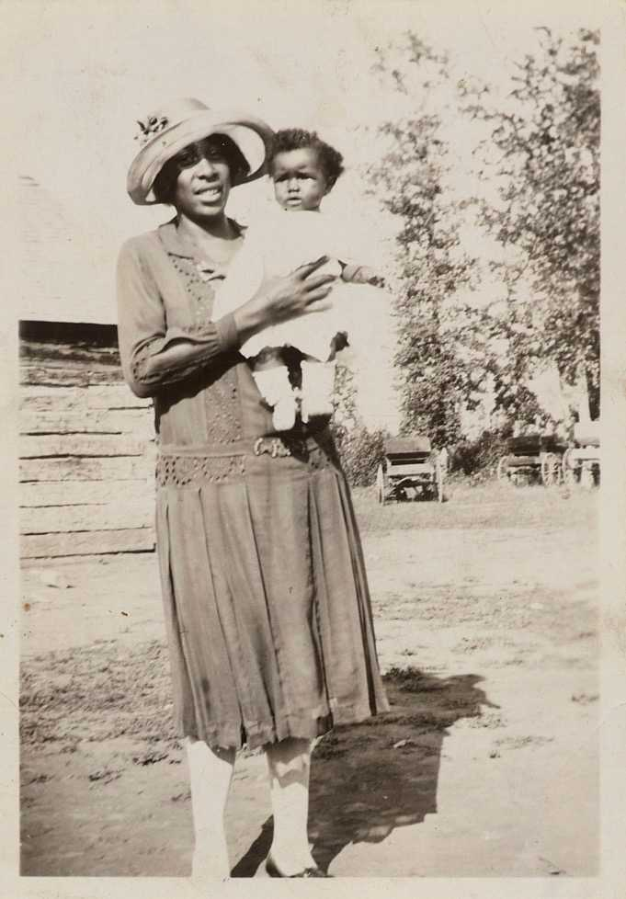
Ladell Carothers’ Daughter (Bowen), 1927. Vernacular photographs often capture tender moments, like in this image of a mother and her young child.

Slide 18
Leon, Oadie, and Monroe Jamerson, n.d.

Slide 19
William S. A. Beal, Self-Portrait, c.1918.

Slide 20
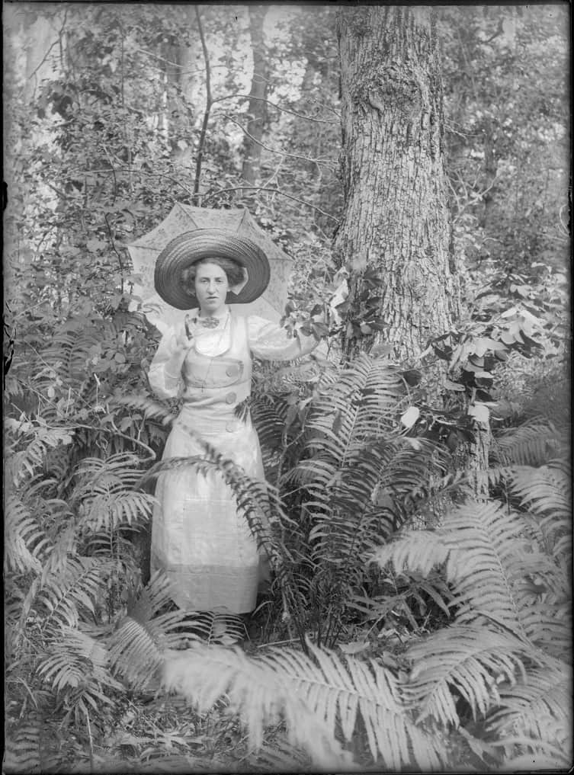
William S. A. Beal, Lillian Elizabeth Henderson, Big Woody district, Swan River, Manitoba, c.1920. In addition to his self-portrait, Beal also took portraits of community members.

Slide 21
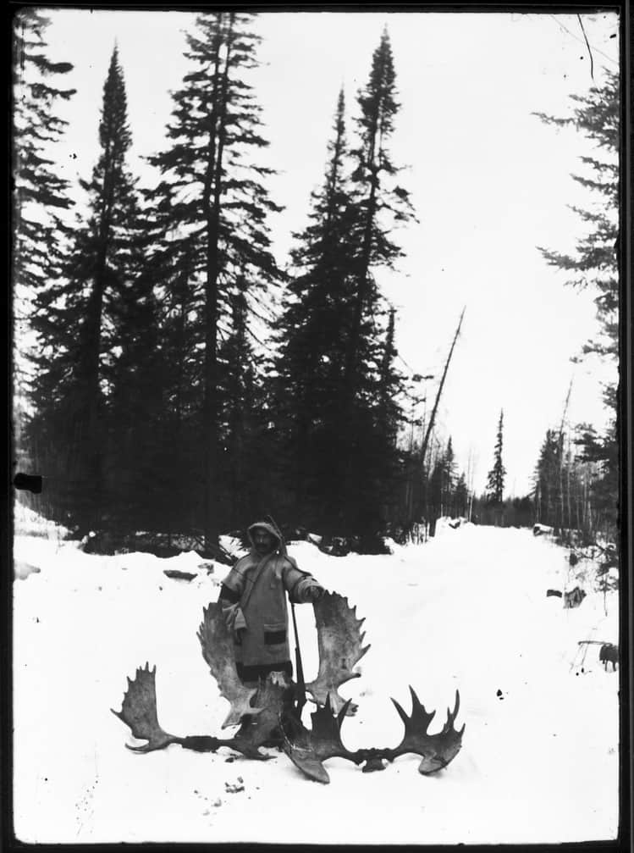
William S. A. Beal, Hunter Riley Montgomery, c.1918, with the antlers of moose. This is another example of Beal’s skilled portrait techniques.

Slide 22
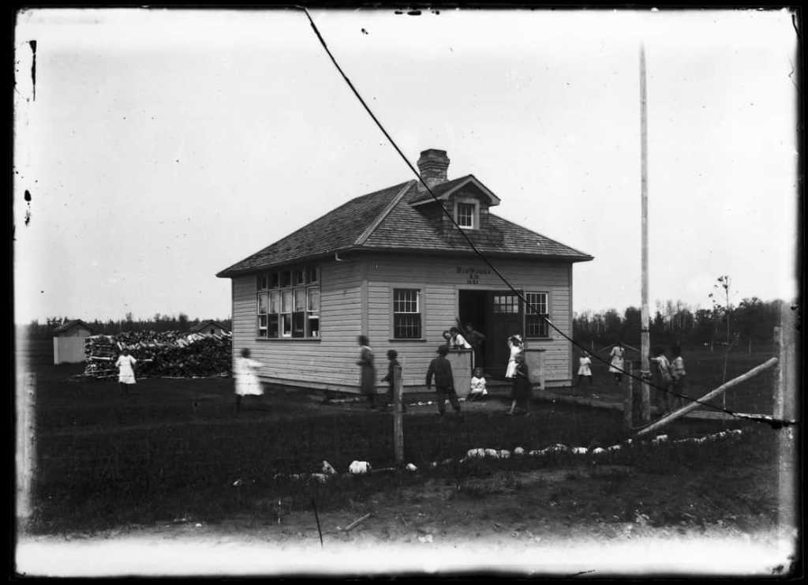
William S. A. Beal, Big Woody School, 1918. Beal was involved in the creation of this school, which is used as a town hall today.

Slide 23
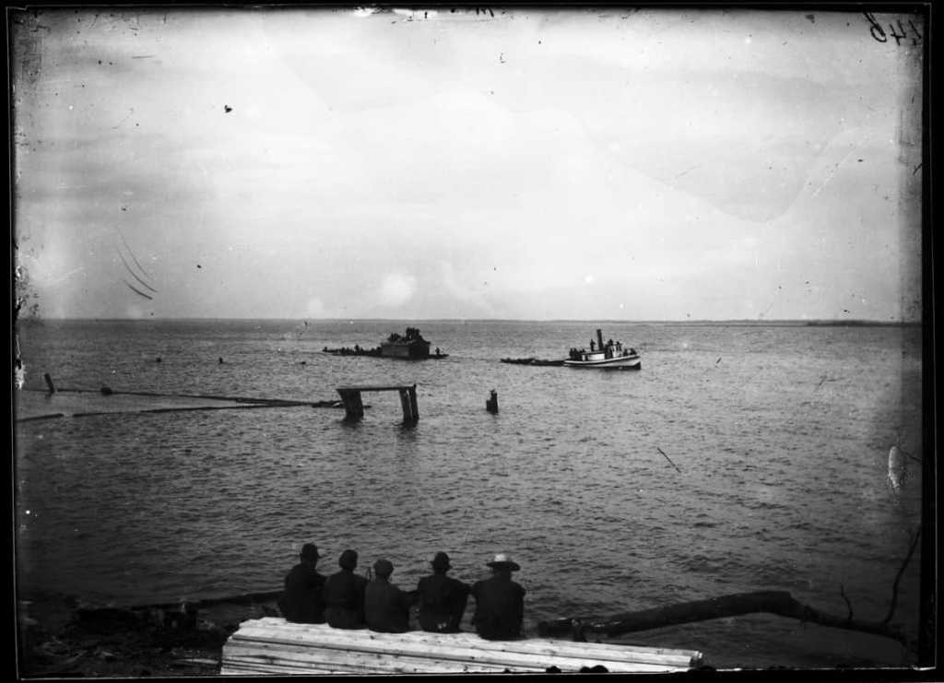
William S. A. Beal, The Florence Cavanaugh tugboat towing a wanigan on Red Deer Lake, c.1920.

Slide 24
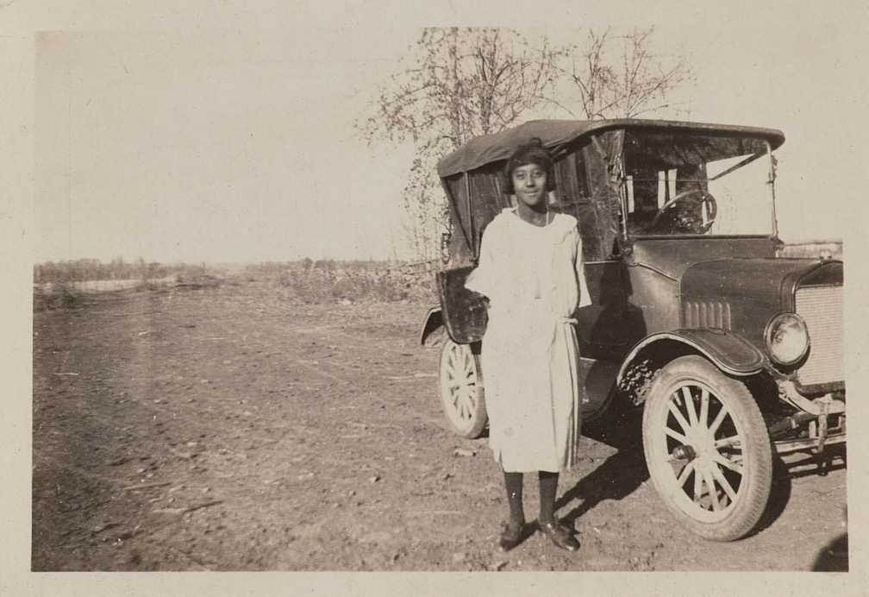
Miss Richson and her car, 1923. A young woman stands beside a car on a rural road in Amber Valley, Alberta.

Slide 25
Amber Valley Group at Lac LaBiche, 1938. Smiling friends enjoying a day at the lake.

Slide 26
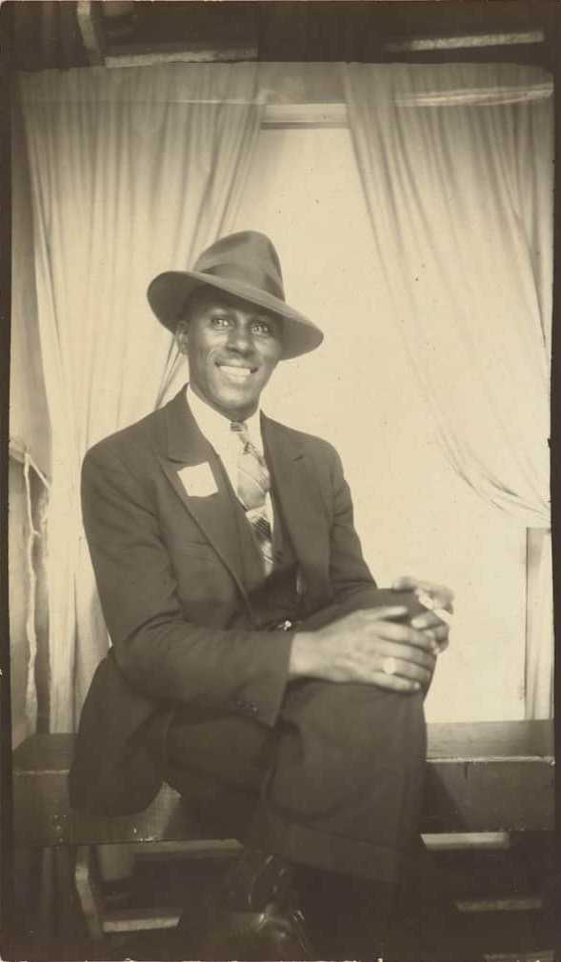
Clarence Coleman in Winnipeg, 1942. This dapper portrait reflects conventions of studio photography around the mid-twentieth century.

Slide 27
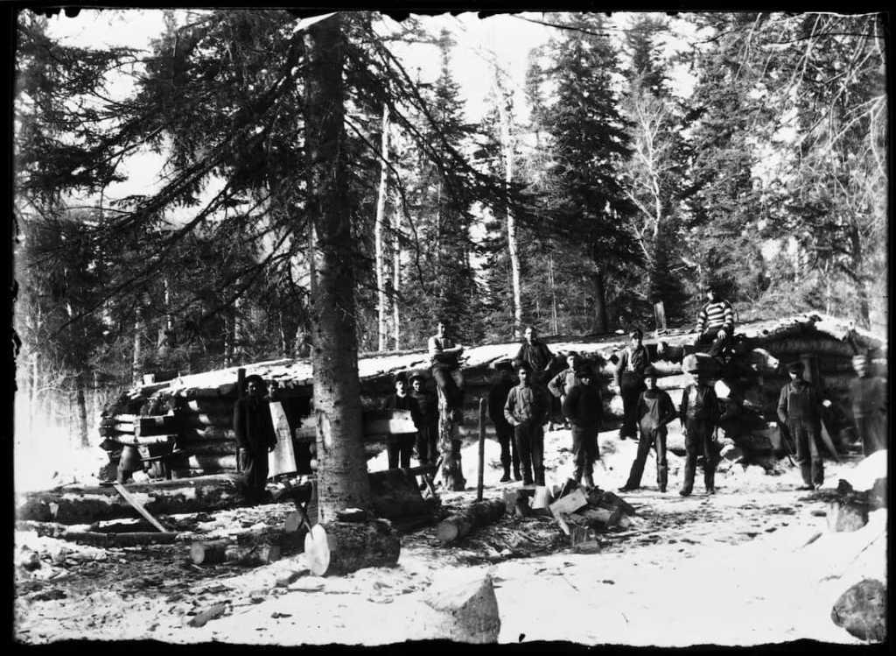
William S. A. Beal, Group of men in front of combination cookshack and bunkhouse, probably near Red Deer Lake, Manitoba, c.1920. This is an example of Beal’s vernacular photography.

Slide 28
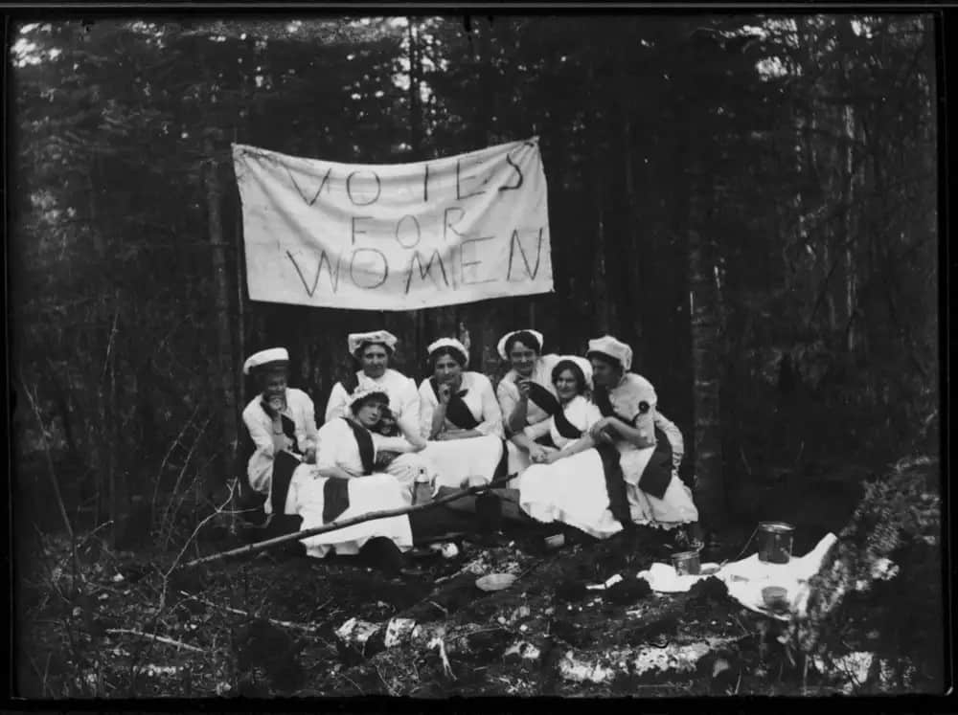
William S. A. Beal, A Group of Thunder Hill, Man., Suffragettes Pose for Billy Beal’s Camera (detail), c.1915. This image pictures a group of women advocating for equal voting rights.

Slide 29
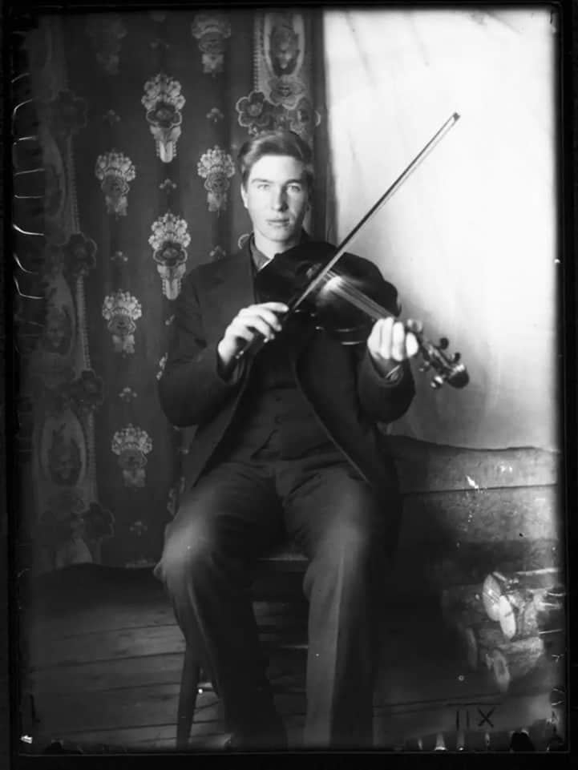
William S. A. Beal, Untitled, c.1917. This portrait by Beal pictures a local fiddle player, identified as “King Sannas.”

Slide 30
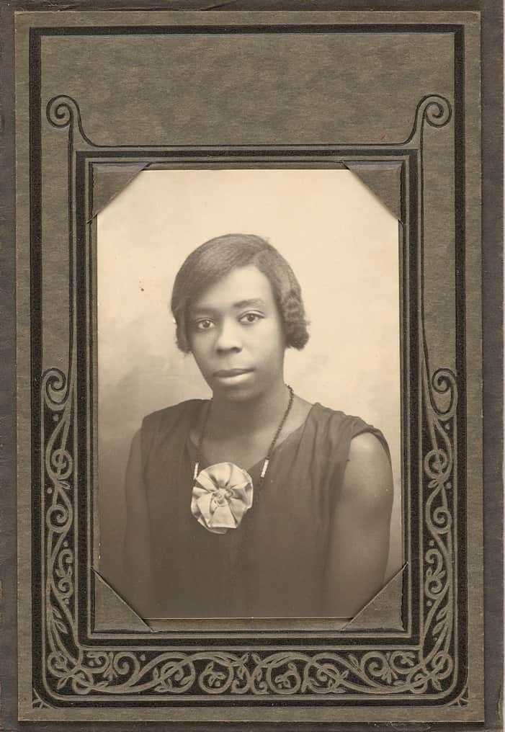
Nellie Wagner, 1926. Formal studio portraits allowed for carefully composed self-presentation.

Slide 31
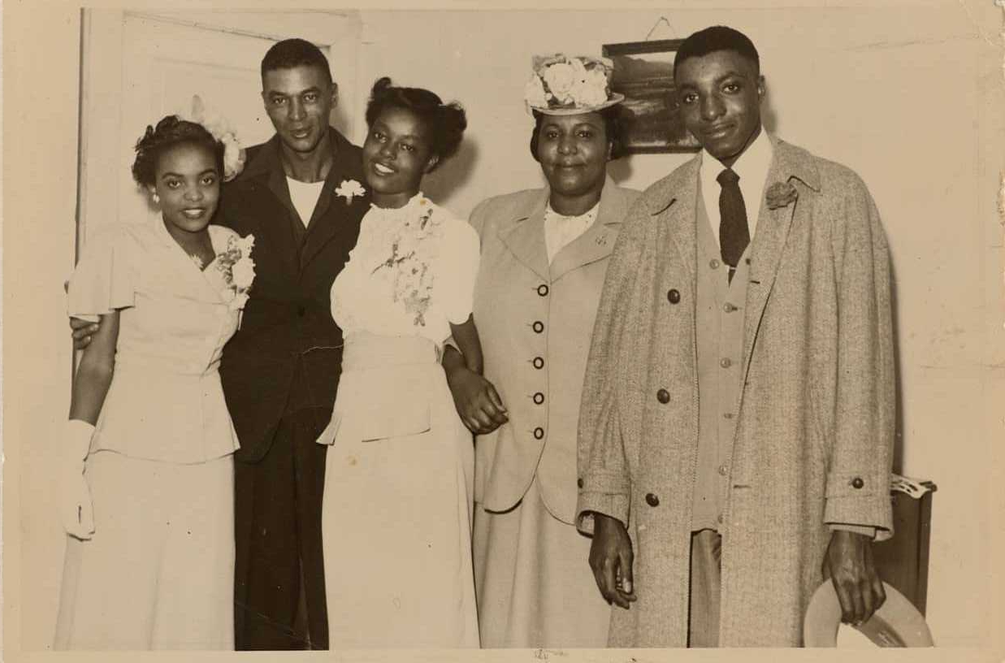
Amber Valley Group, n.d. Documenting kinships and community life, vernacular photographs are important everyday records of belonging.

