Slide 1
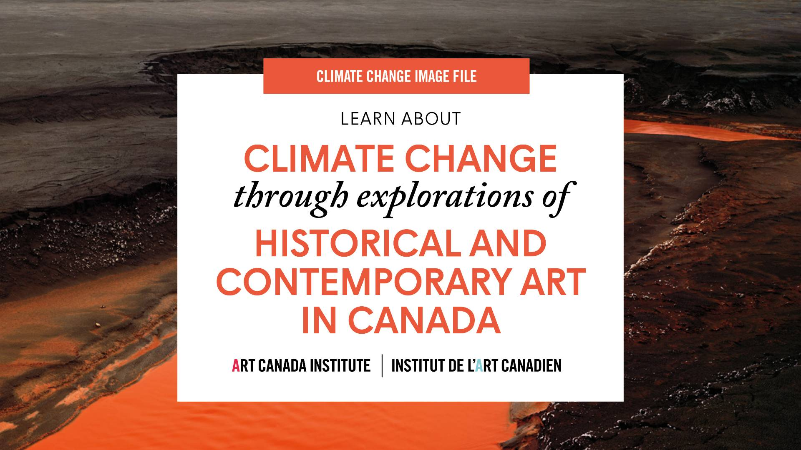

Slide 2
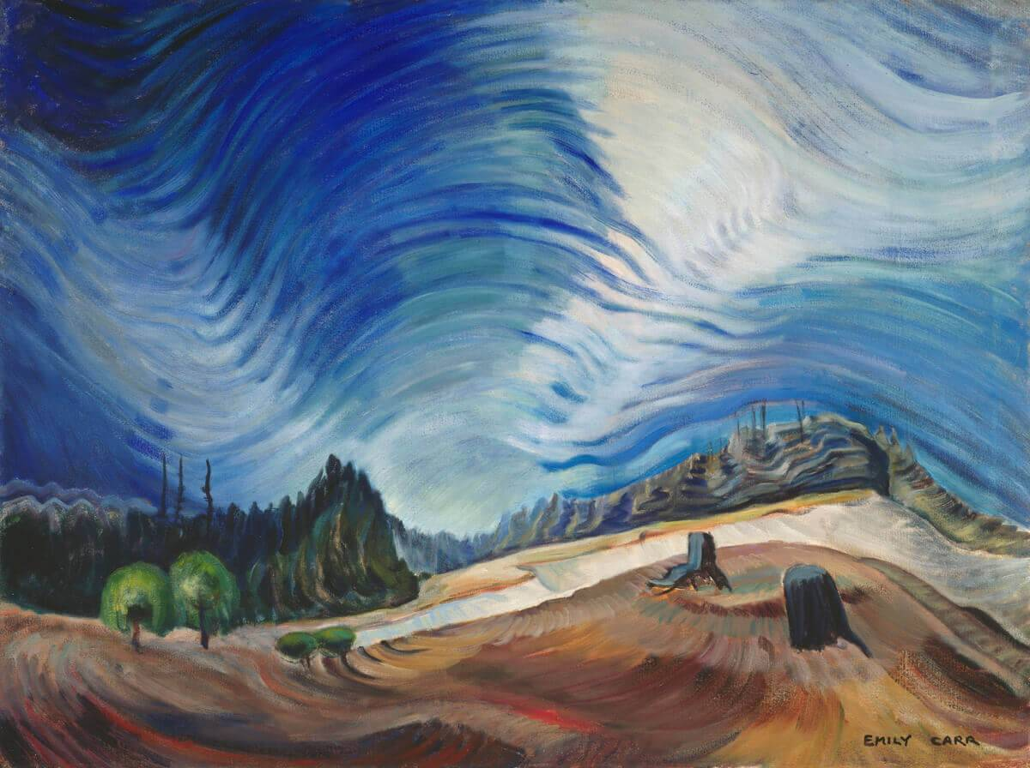
Emily Carr, Above the Gravel Pit, 1937. In the 1930s Carr focused her attention on the landscape surrounding her Victoria home.

Slide 3
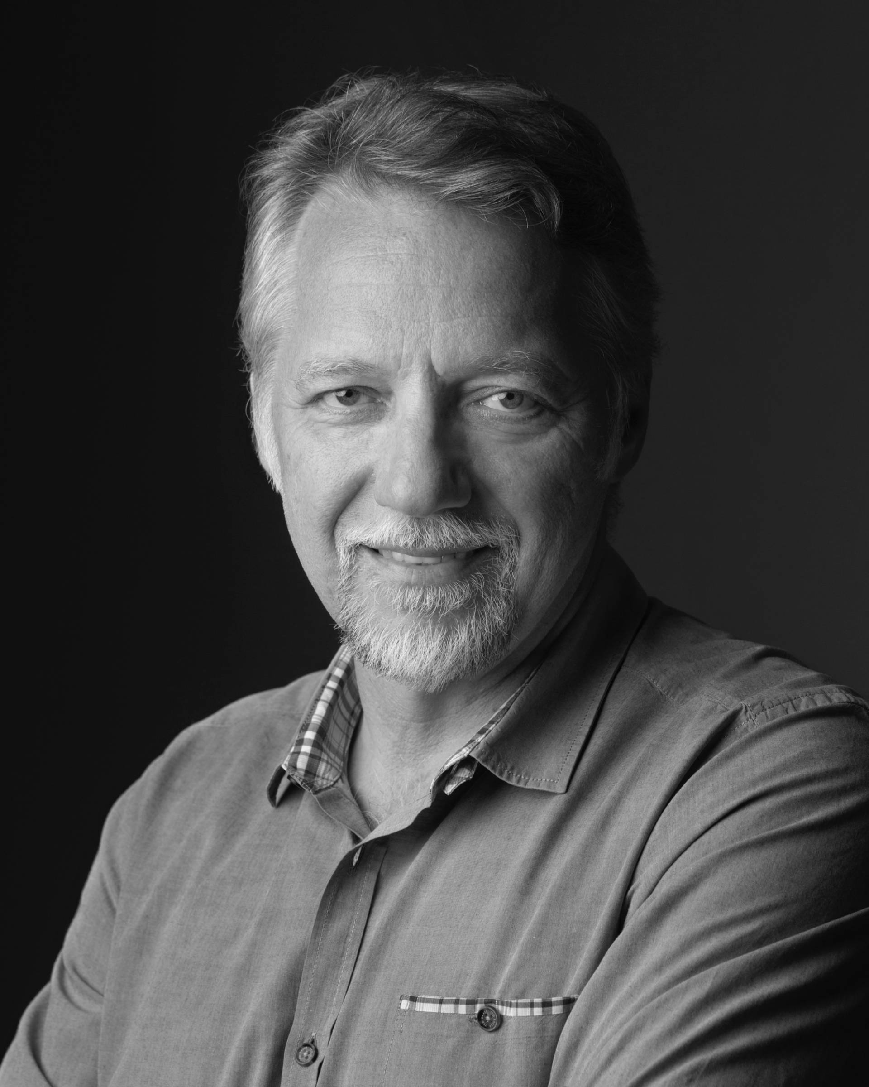
Edward Burtunsky.

Slide 4
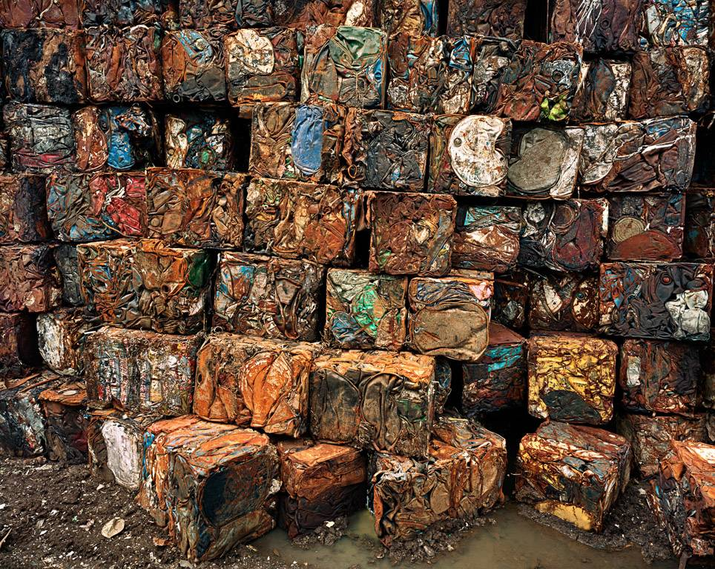
Edward Burtynsky, Densified Oil Drums #4, Hamilton, Ontario, 1994. This work is from a series exploring materials collected in large recycling yards.

Slide 5
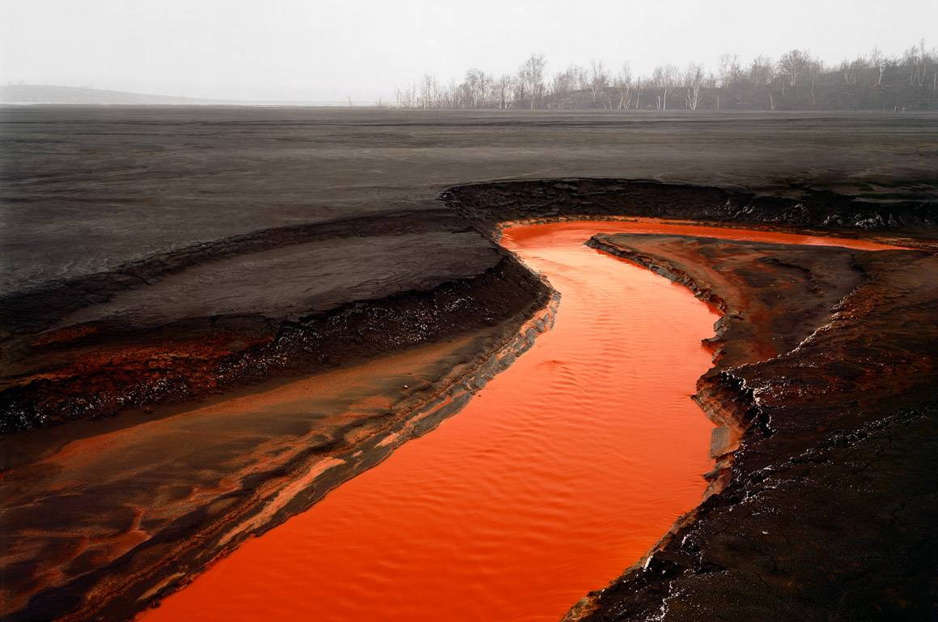
Edward Burtynsky,
Nickel Tailings #34, Sudbury, Ontario, 1996. The bright red and orange in this image is caused by the oxidization of iron in mining.

Slide 6
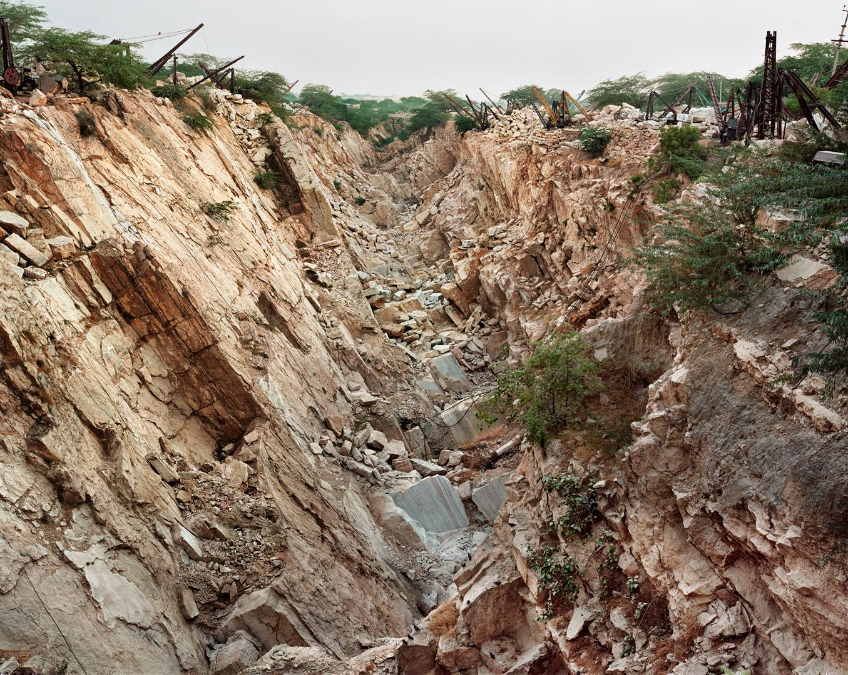
Edward Burtynsky, Makrana Marble Quarries #3, Rajasthan, India, 2000. Burtynsky has photographed quarries in several countries.

Slide 7
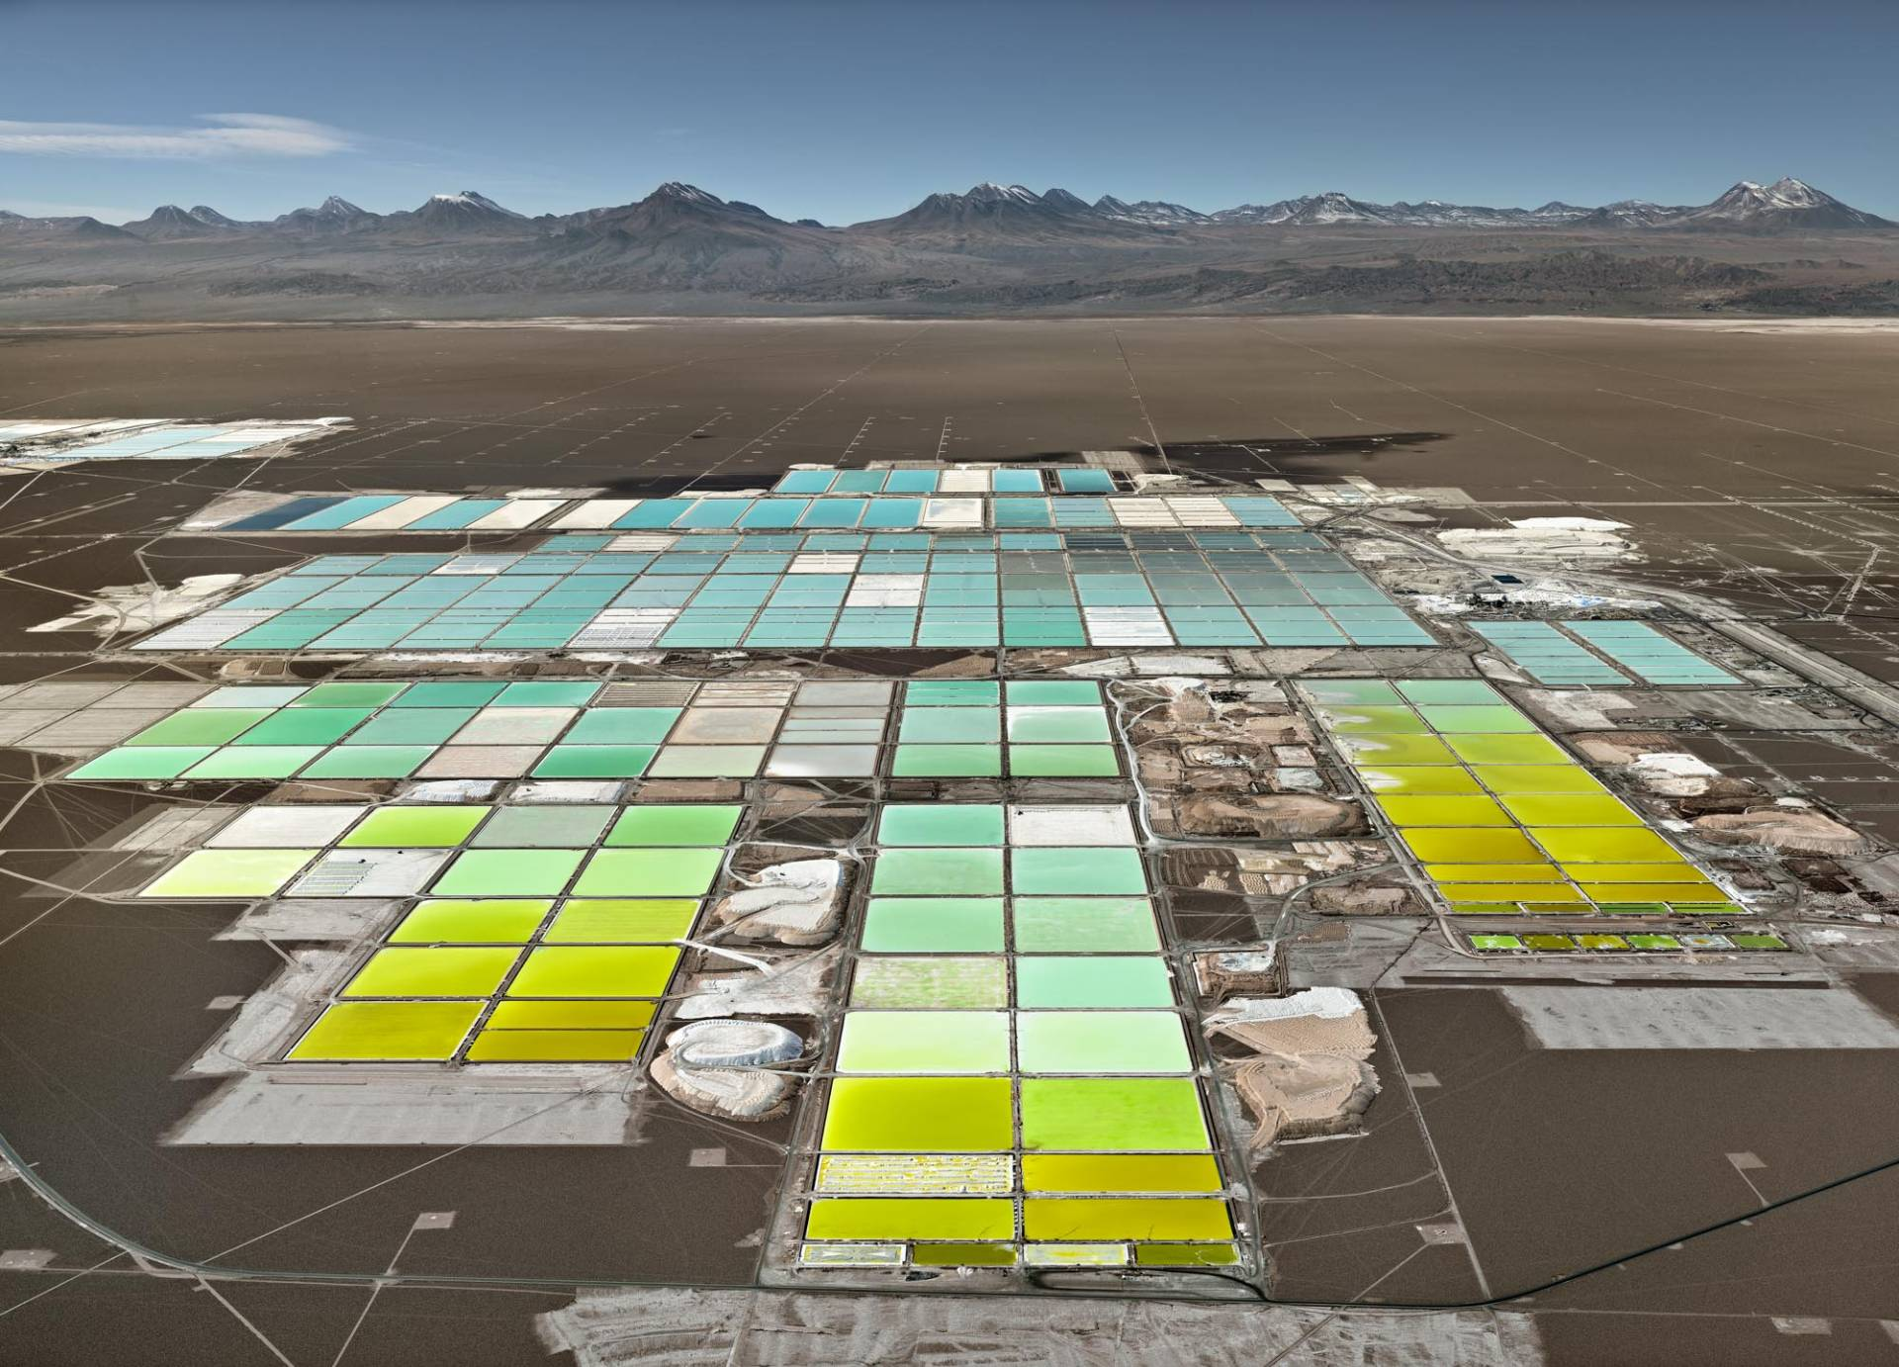
Edward Burtynsky, Lithium Mines #1, Salt Flats, Atacama Desert, Chile, 2017. This image is part of The Anthropocene Project.

Slide 8
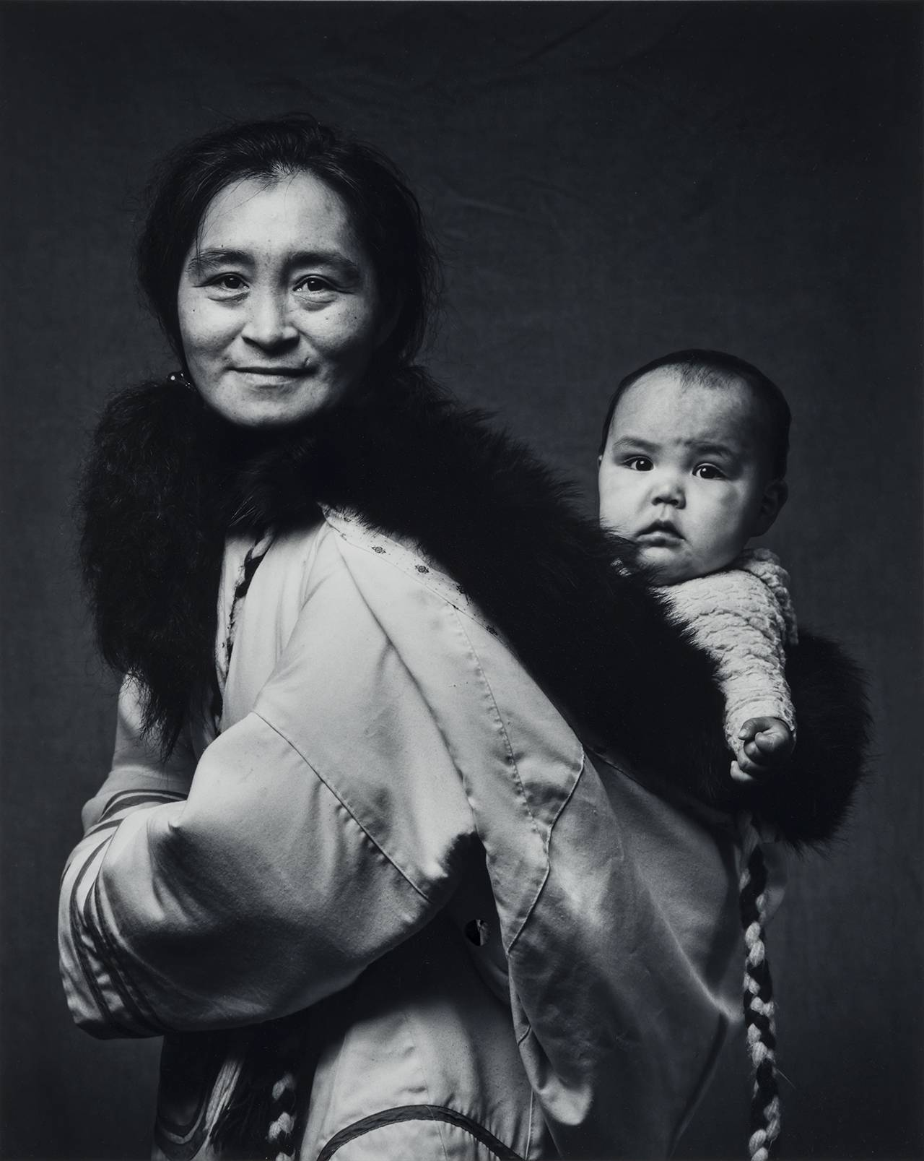
Jerry Riley, Oviloo and Granddaughter Tye, 1990.

Slide 9
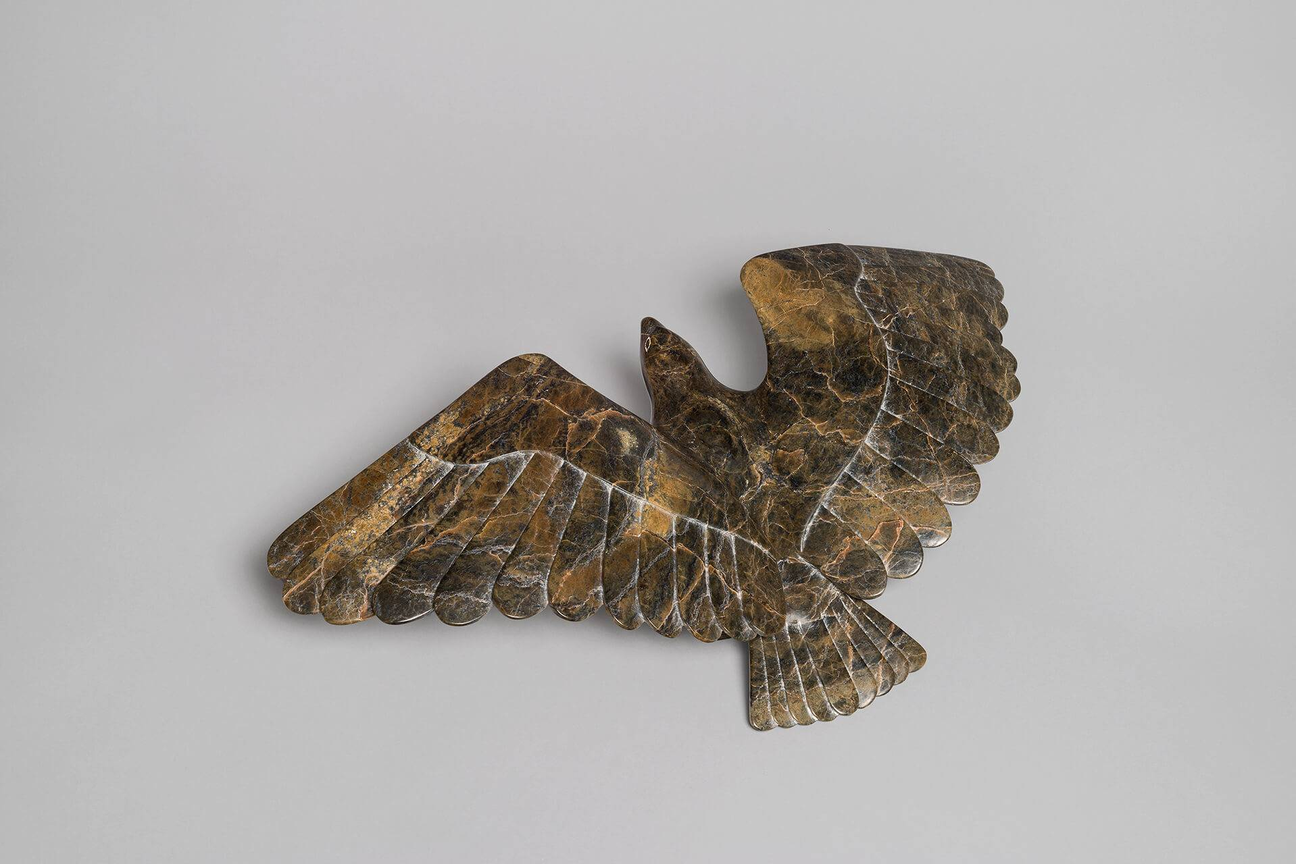
Oviloo Tunnillie, Hawk Taking Off, c.1987. This work reveals Tunnillie’s talent for realistic sculptures of animals.

Slide 10
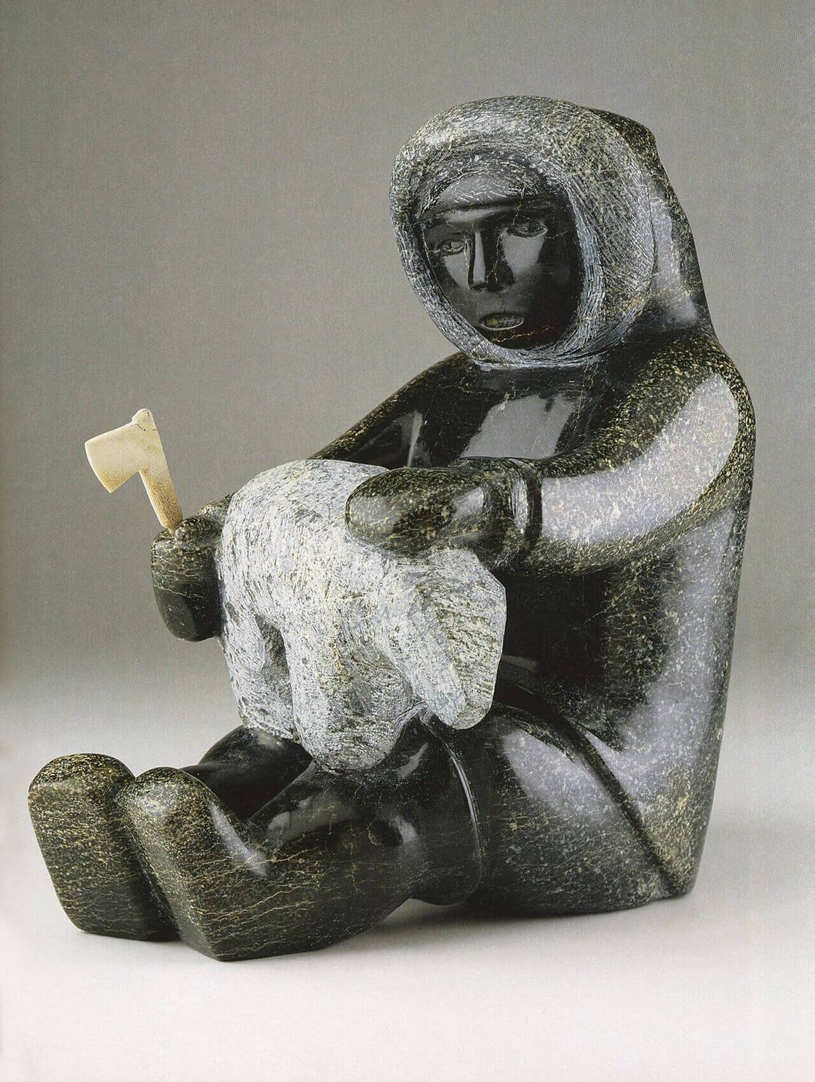
Oviloo Tunnillie, My Father Carving a Bear, 2004. As a young artist, Tunnillie was inspired by her father’s practice.

Slide 11
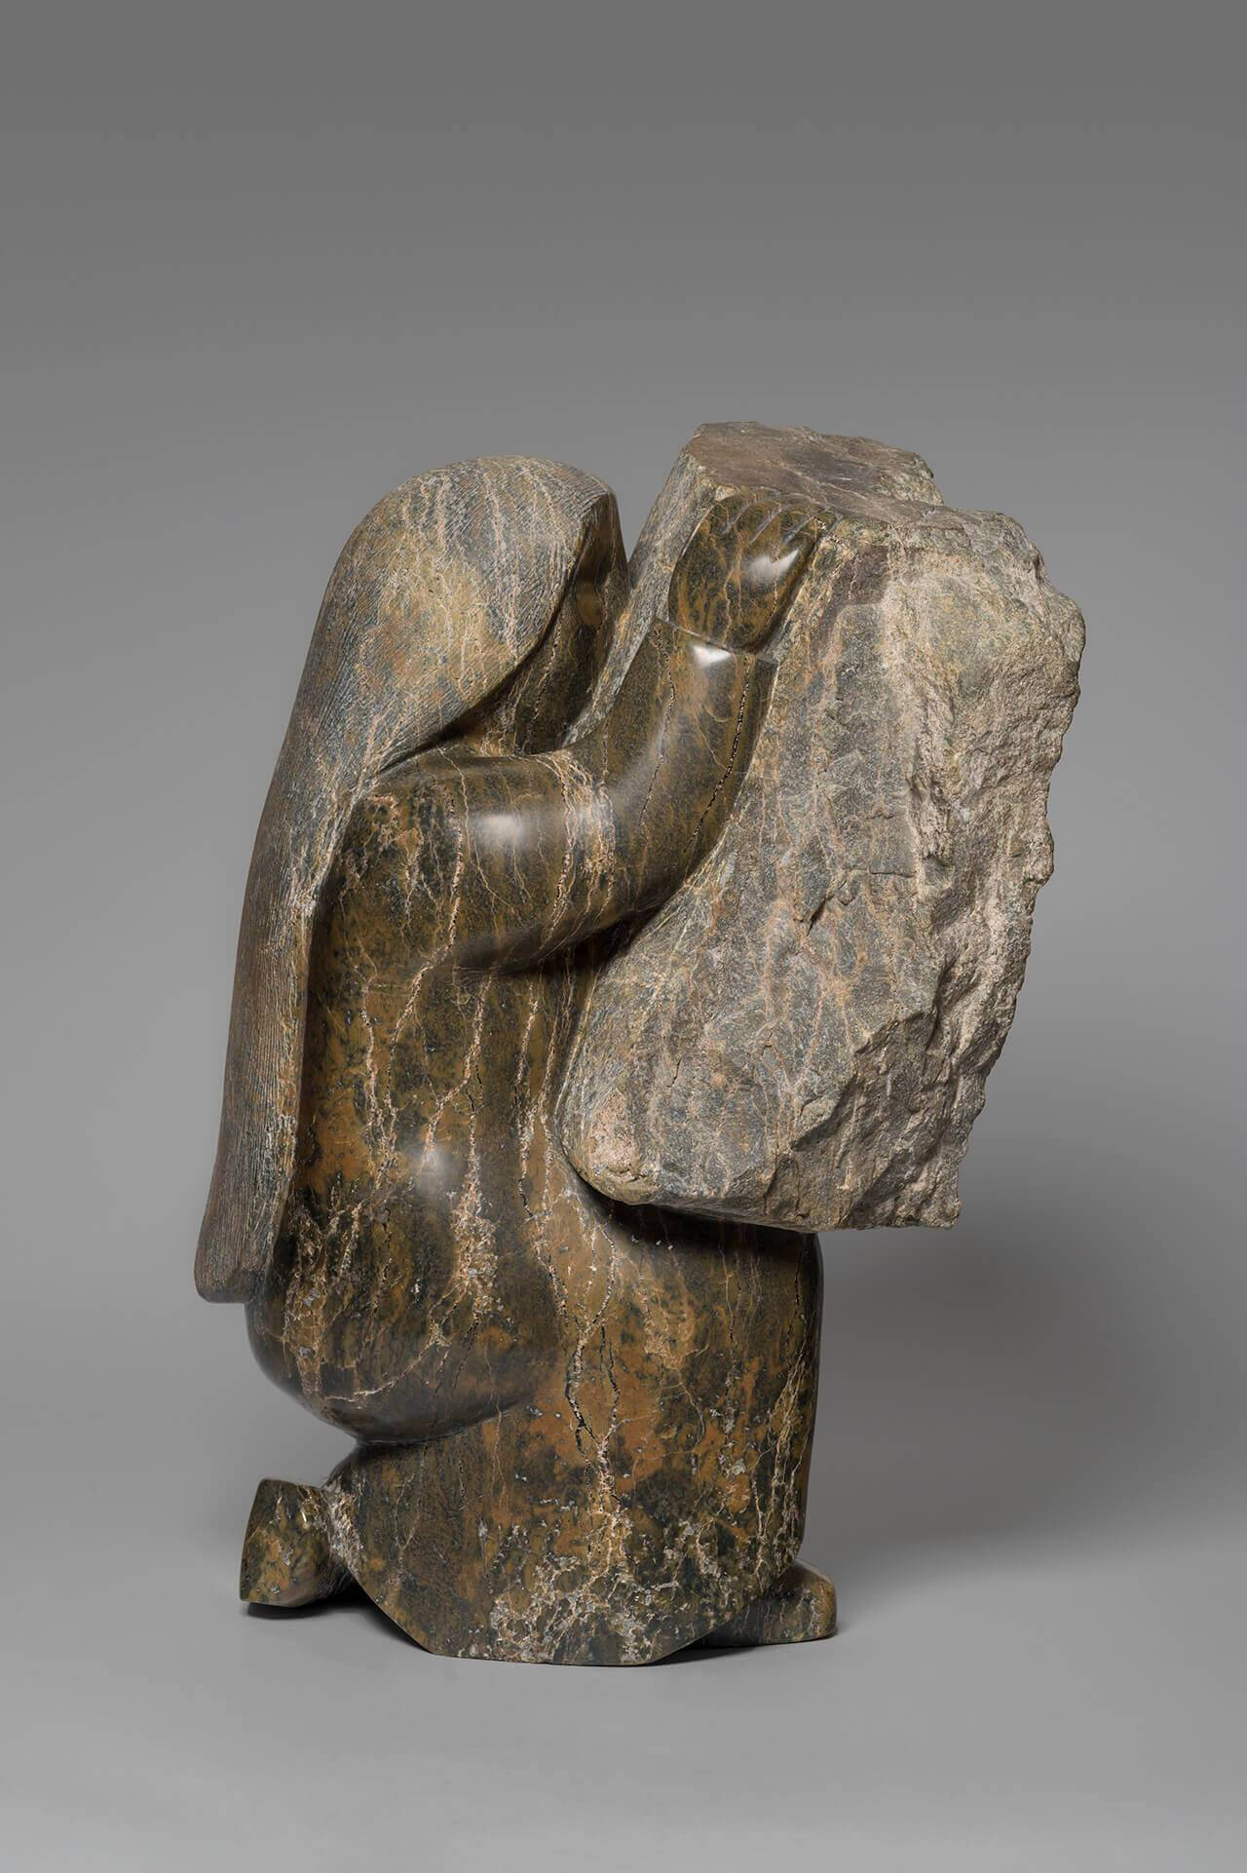
Oviloo Tunnillie, Self-Portrait with Carving Stone, 1998. In this large sculpture, the artist appears to merge with the stone she is carving.

Slide 12
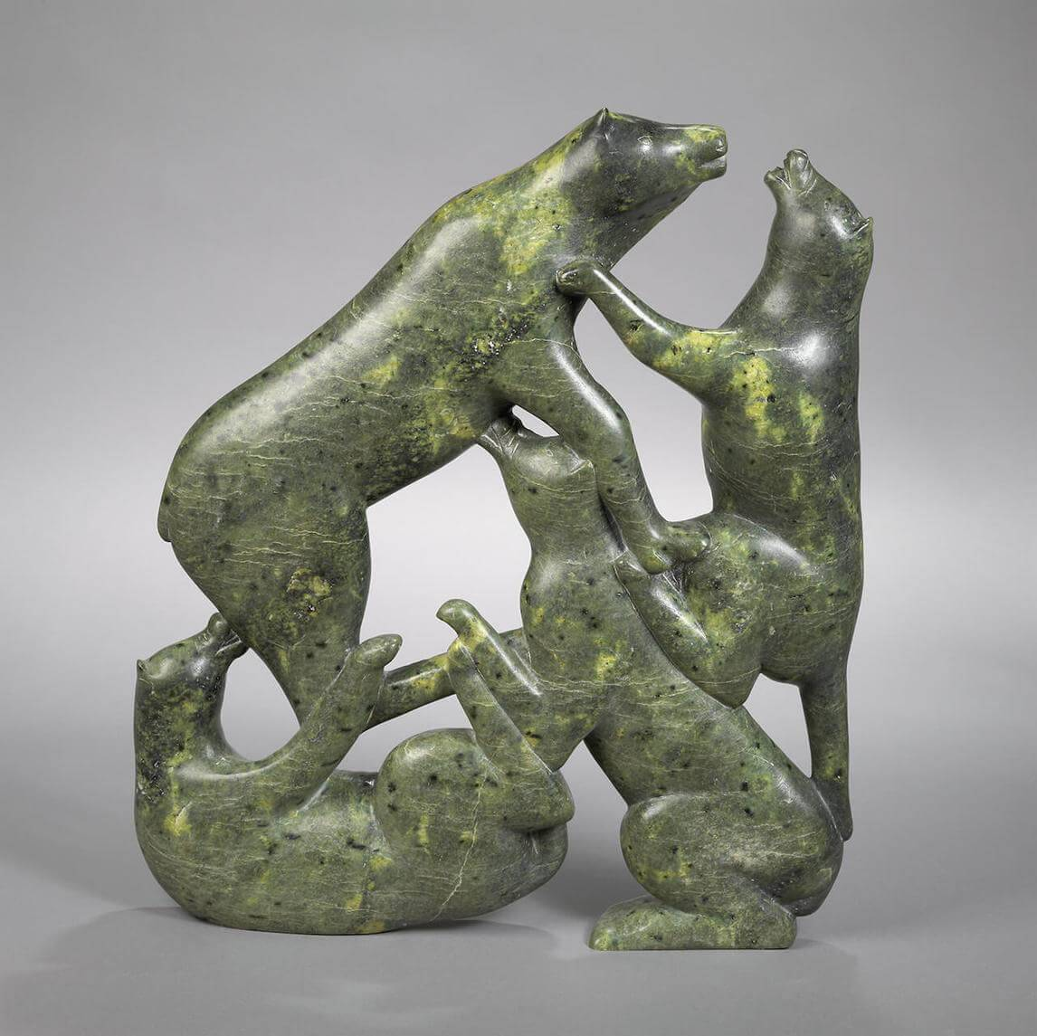
Oviloo Tunnillie, Dogs Fighting, c.1975. Dogs were an important part of Tunnillie’s community.

Slide 13
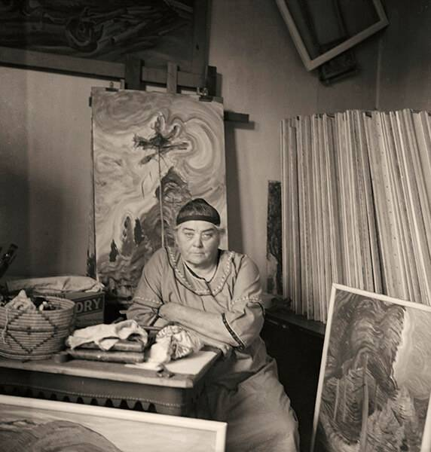
Emily Carr in
Her Studio, 1939.

Slide 14
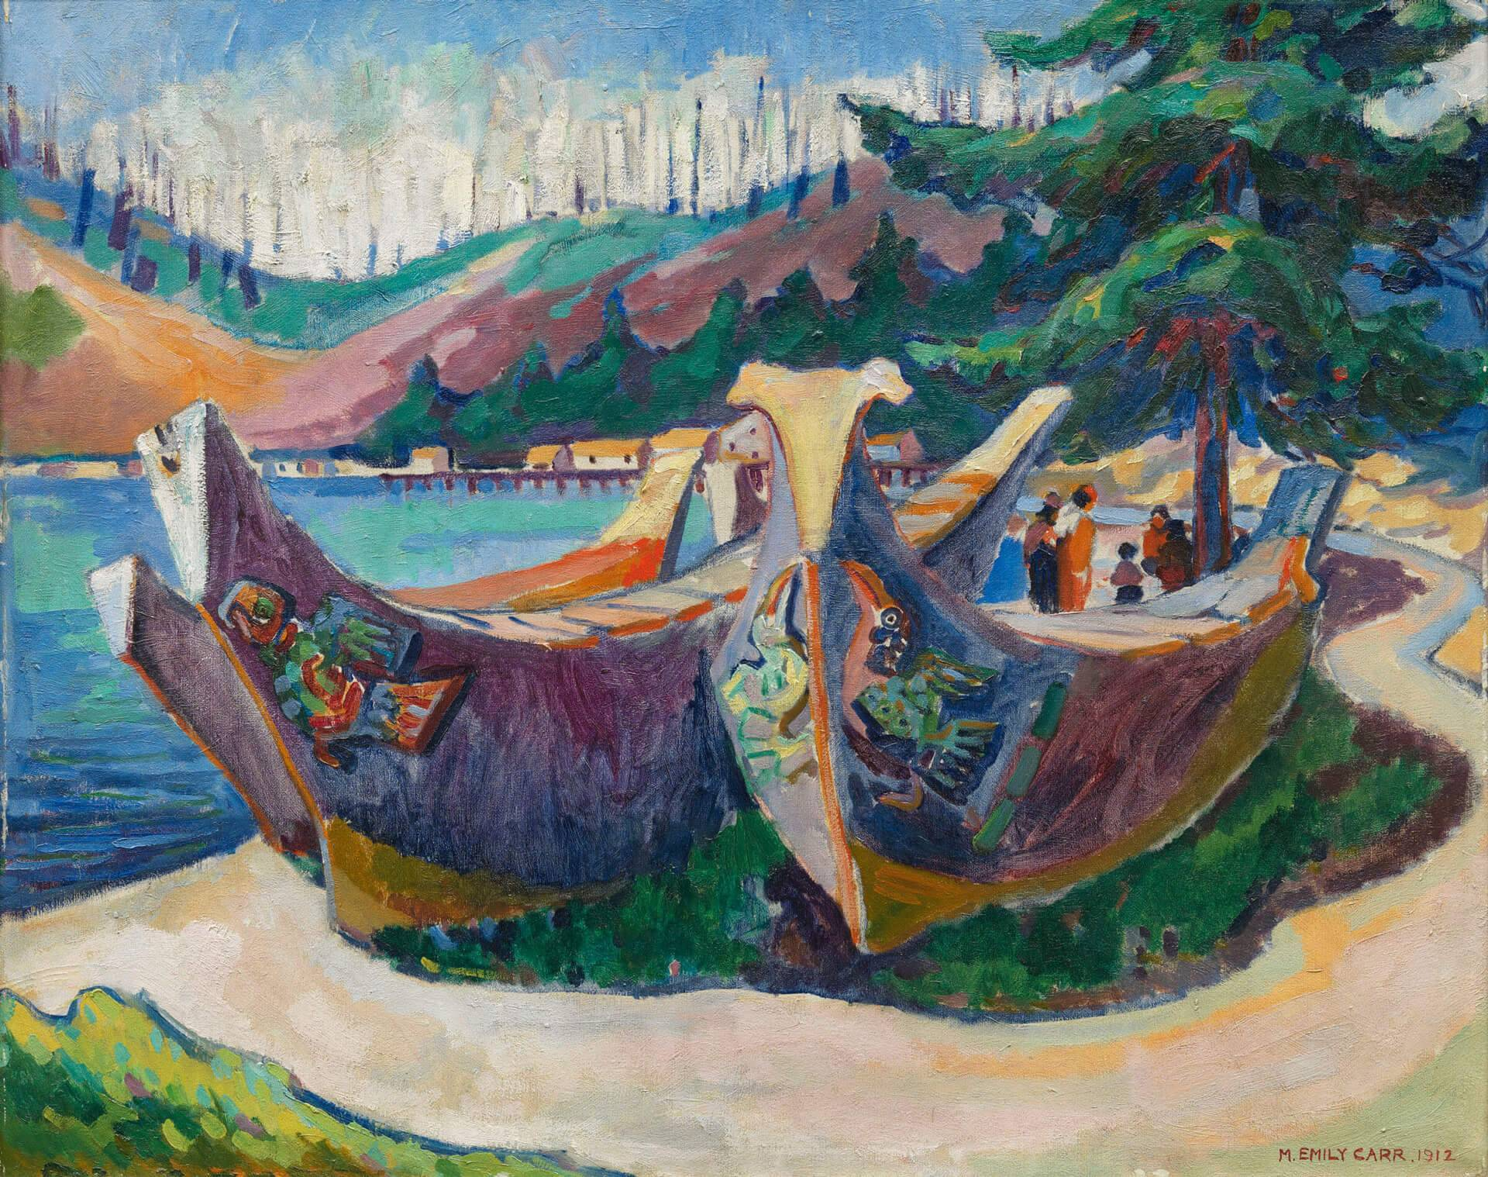
Emily Carr, War Canoes, Alert Bay, 1912. Early in her career Carr developed a passionate interest in First Nations art and culture.

Slide 15
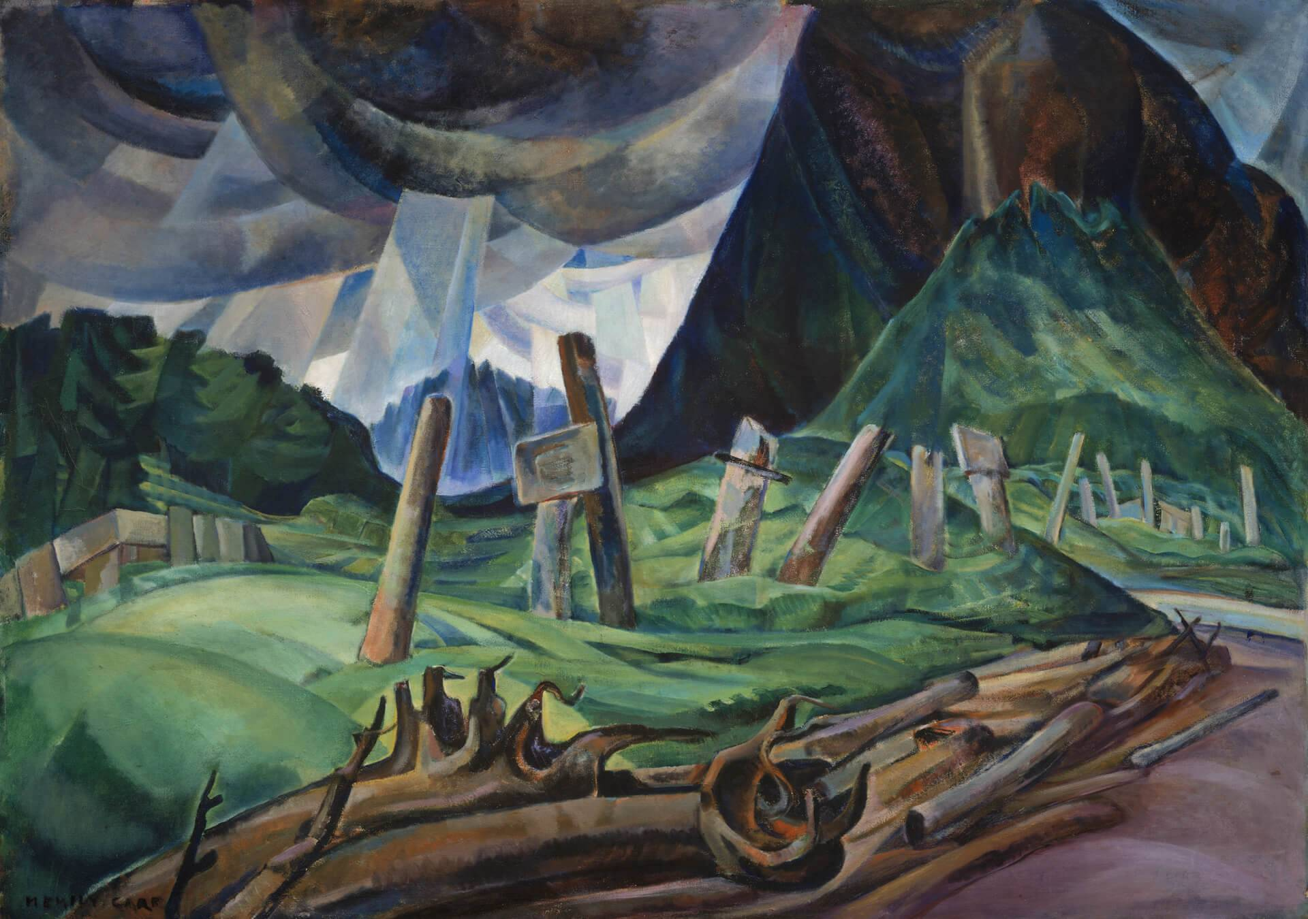
Emily Carr, Vanquished, 1930. This painting depicts totem poles tilting toward the earth in a village that had been abandoned.

Slide 16
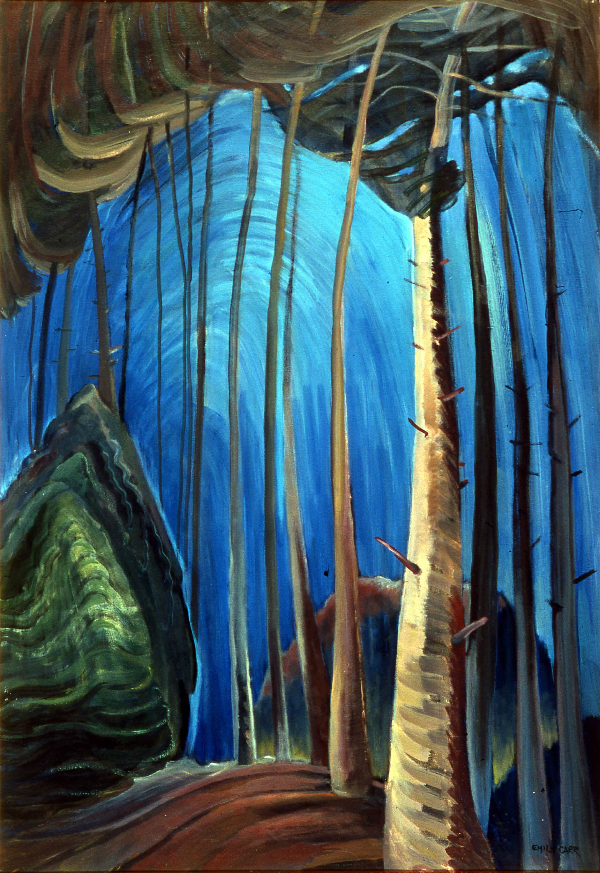
Emily Carr, Blue Sky, 1936. Late in life Carr created paintings that seem to represent forests as spiritual places.

Slide 17
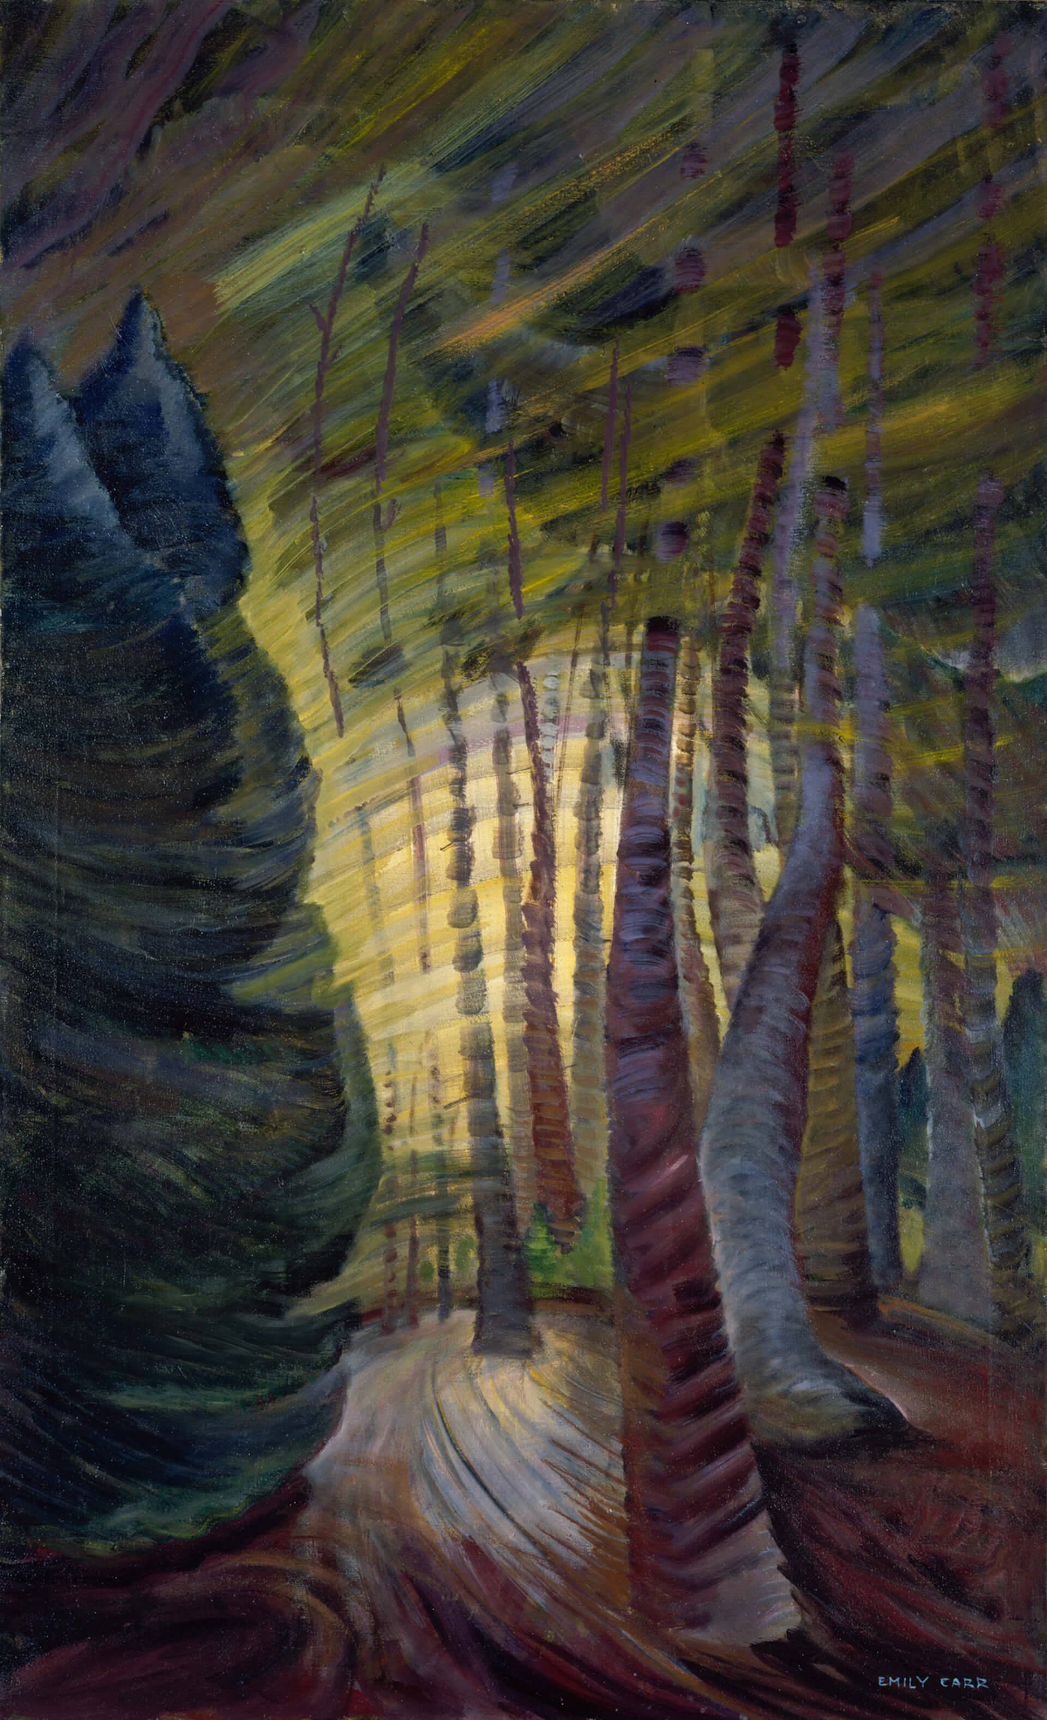
Emily Carr, Sombreness Sunlit, 1938–40. Vibrant brushstrokes are typical of Carr’s final works.

Slide 18
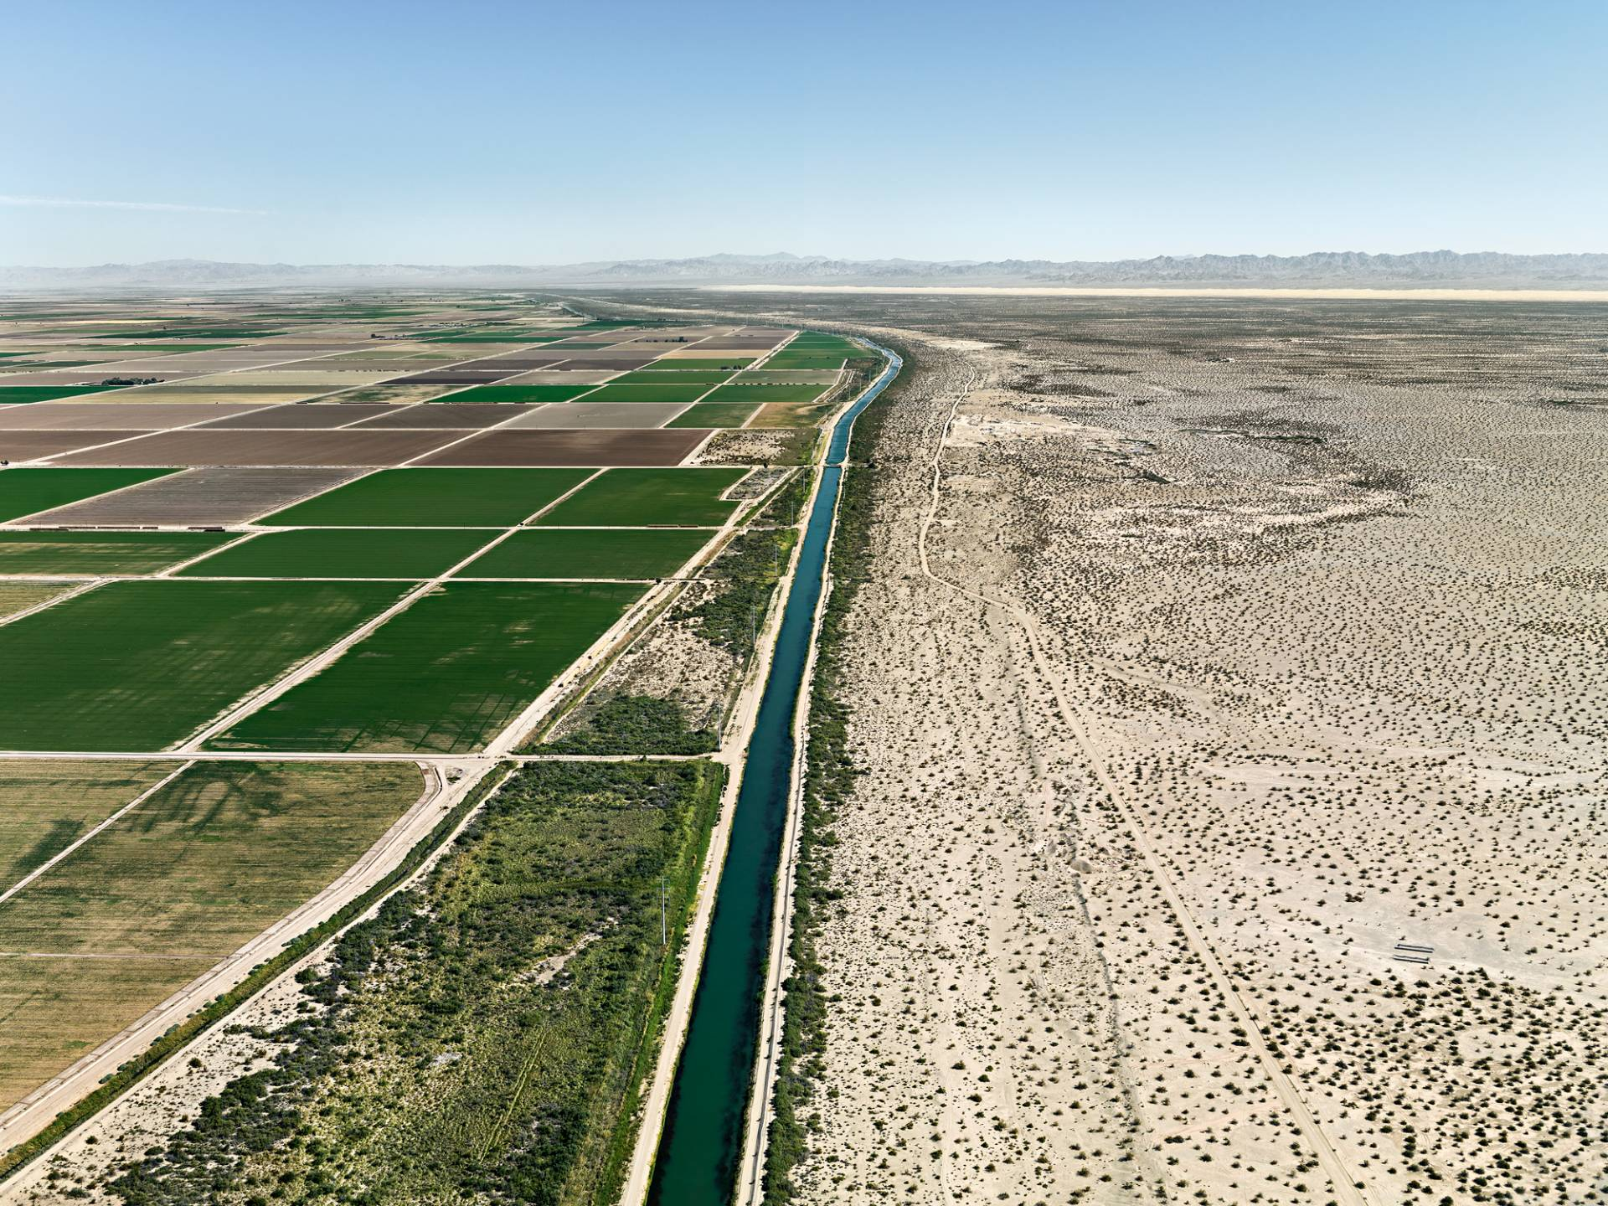
Learning Activity #1
Edward Burtynsky, Row Irrigation, Imperial Valley, Southern California, USA, 2009. This image reveals the power of contemporary irrigation systems.

Slide 19
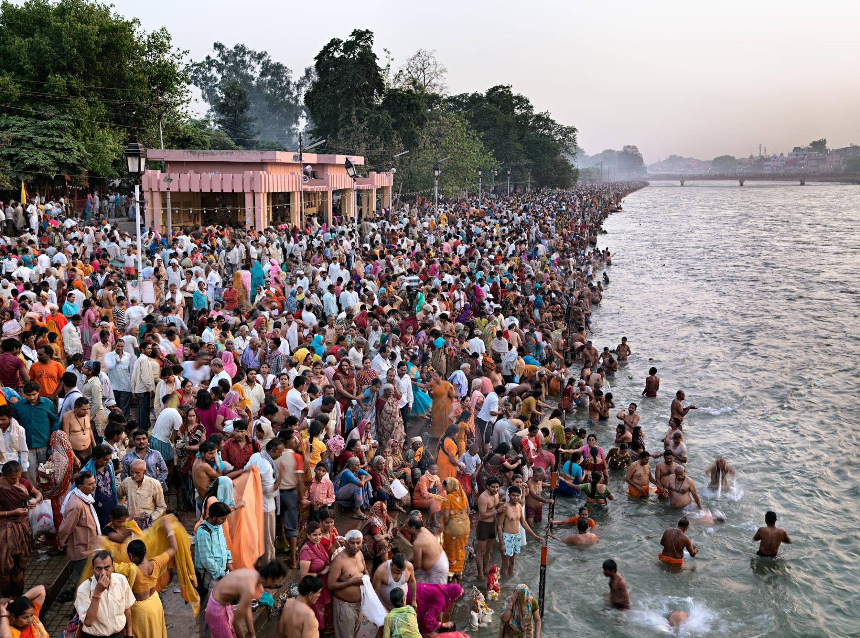
Learning Activity #1
Edward Burtynsky, Kumbh Mela #1, Haridwar, India, 2010. Haridwar is on the Ganges, a river that is deeply sacred for Hindu people.

Slide 20
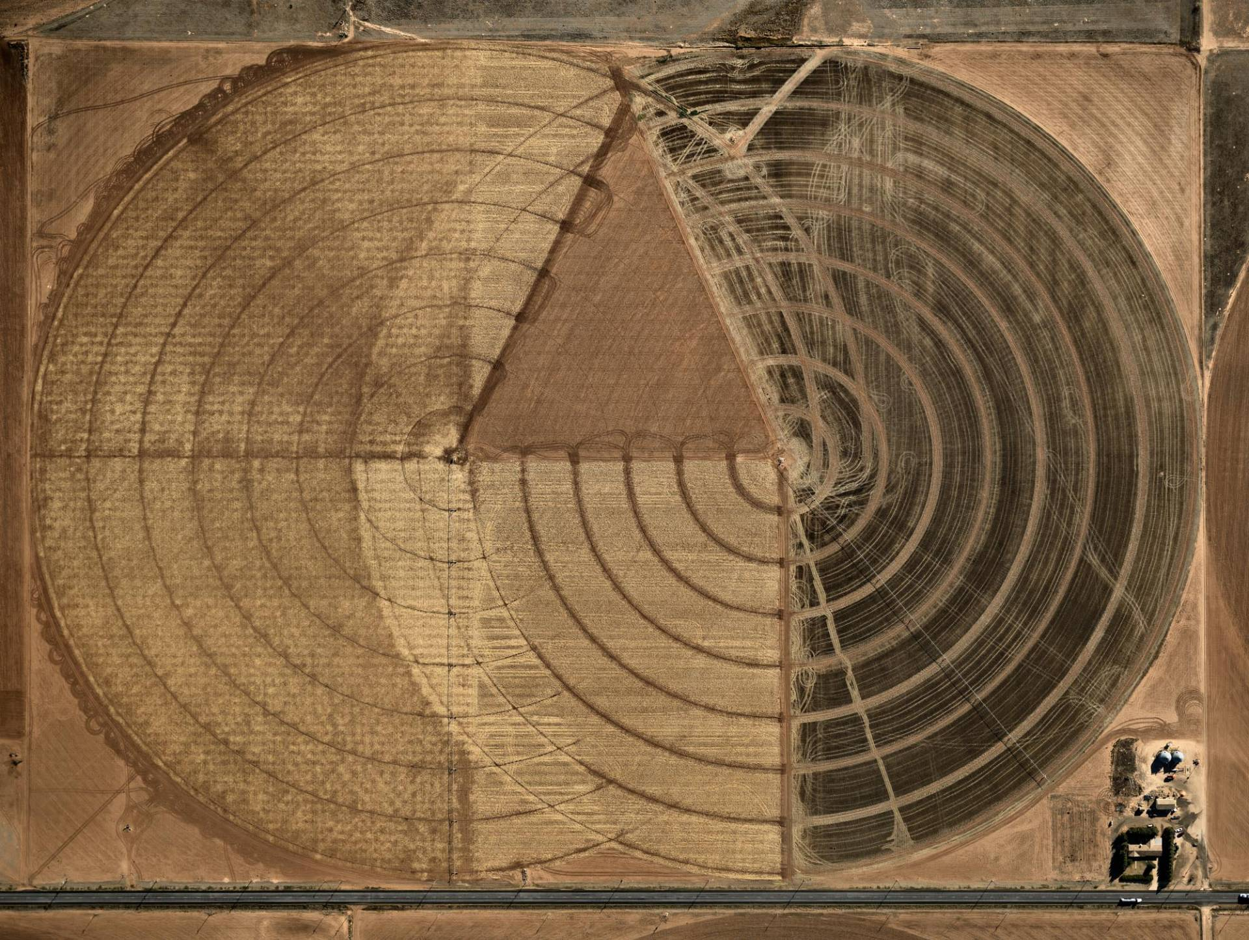
Learning Activity #1
Edward Burtynsky, Pivot Irrigation #1, High Plains, Texas Panhandle, USA, 2011. Burtynsky captured this dramatic landscape from the air.

Slide 21
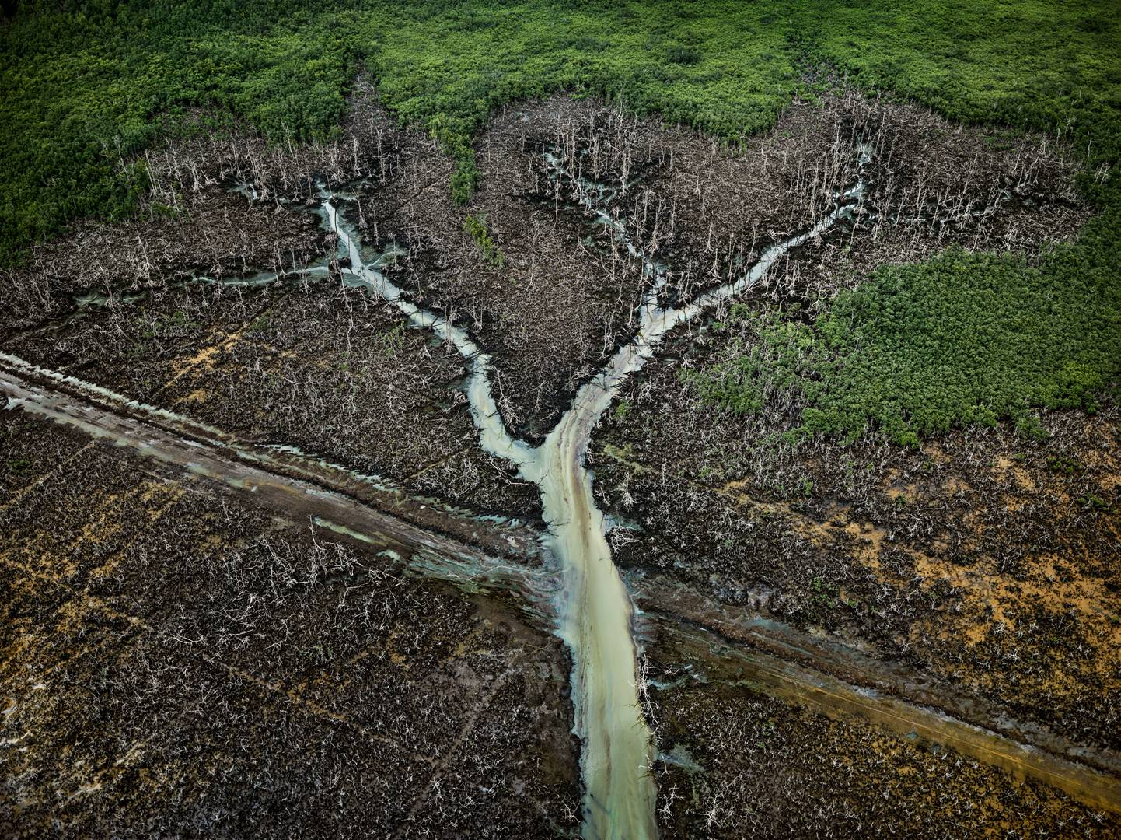
Learning Activity #1
Edward Burtynsky, Oil Bunkering #2, Niger Delta, Nigeria, 2016. This photograph from The Anthropocene Project captures the impact of the oil industry on the land.

Slide 22
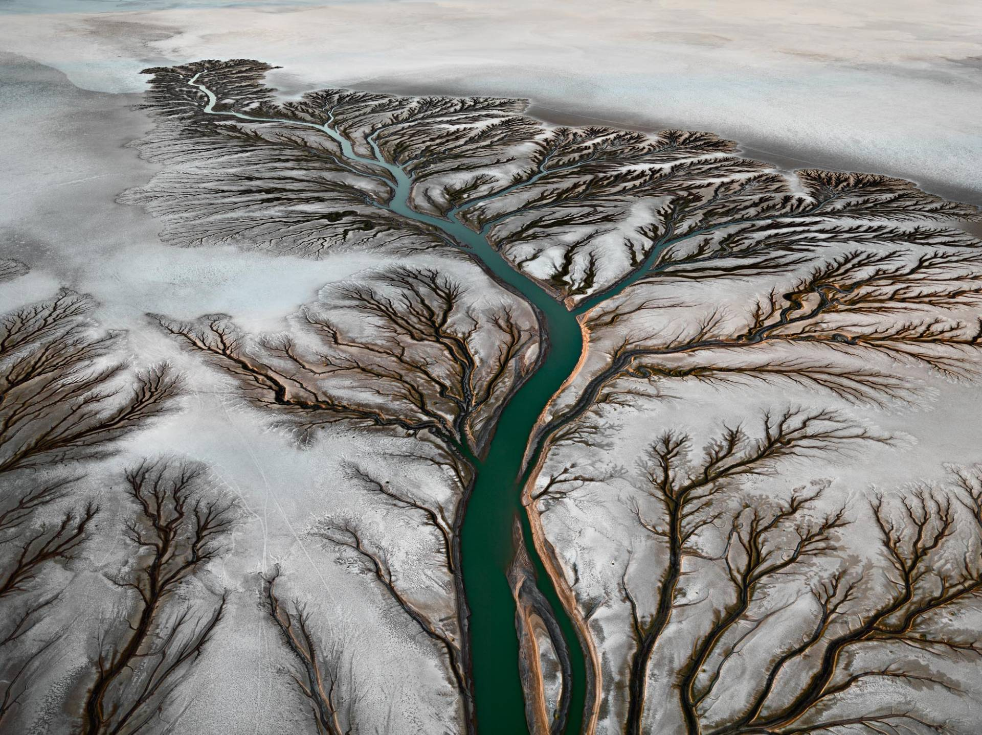
Learning Activity #1
Edward Burtynsky, Colorado River Delta #2, Near San Felipe, Baja, Mexico, 2011. The Colorado River Delta was once a thriving wetland ecosystem, but because of water diversion it lost nearly all of its water.

Slide 23
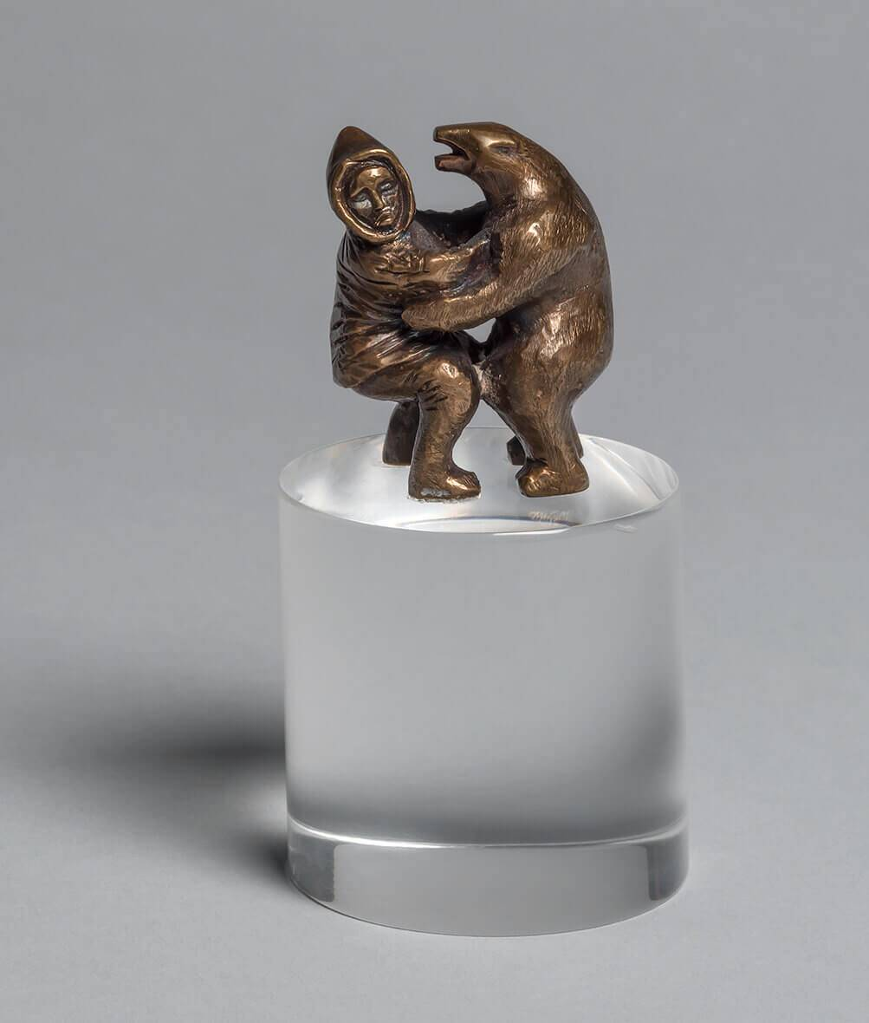
Learning Activity #2
Oviloo Tunnillie, Man and Bear, 1974–76. This sculpture is one of Tunnillie’s earliest works to be included in an exhibition.

Slide 24
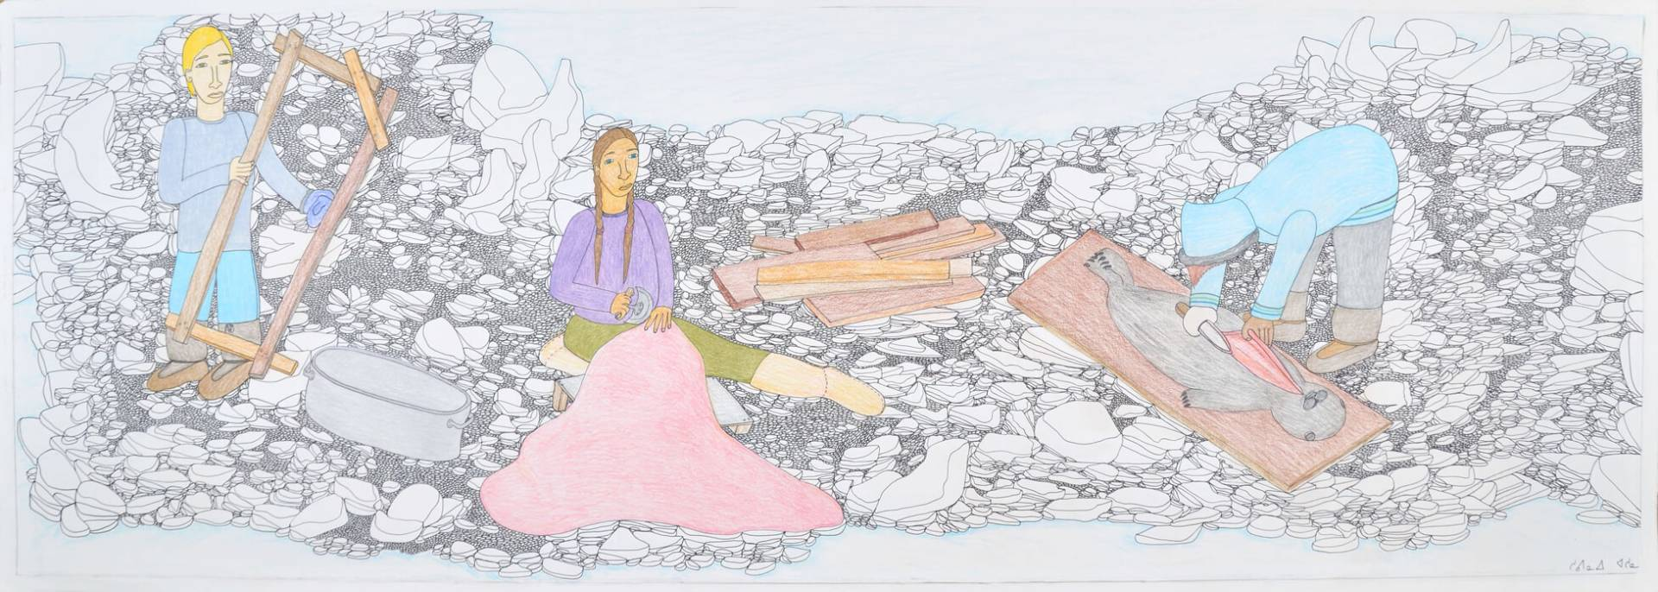
Learning Activity #2
Shuvinai Ashoona, Untitled, 2013. In this drawing Ashoona depicts life on the land in her community.

Slide 25
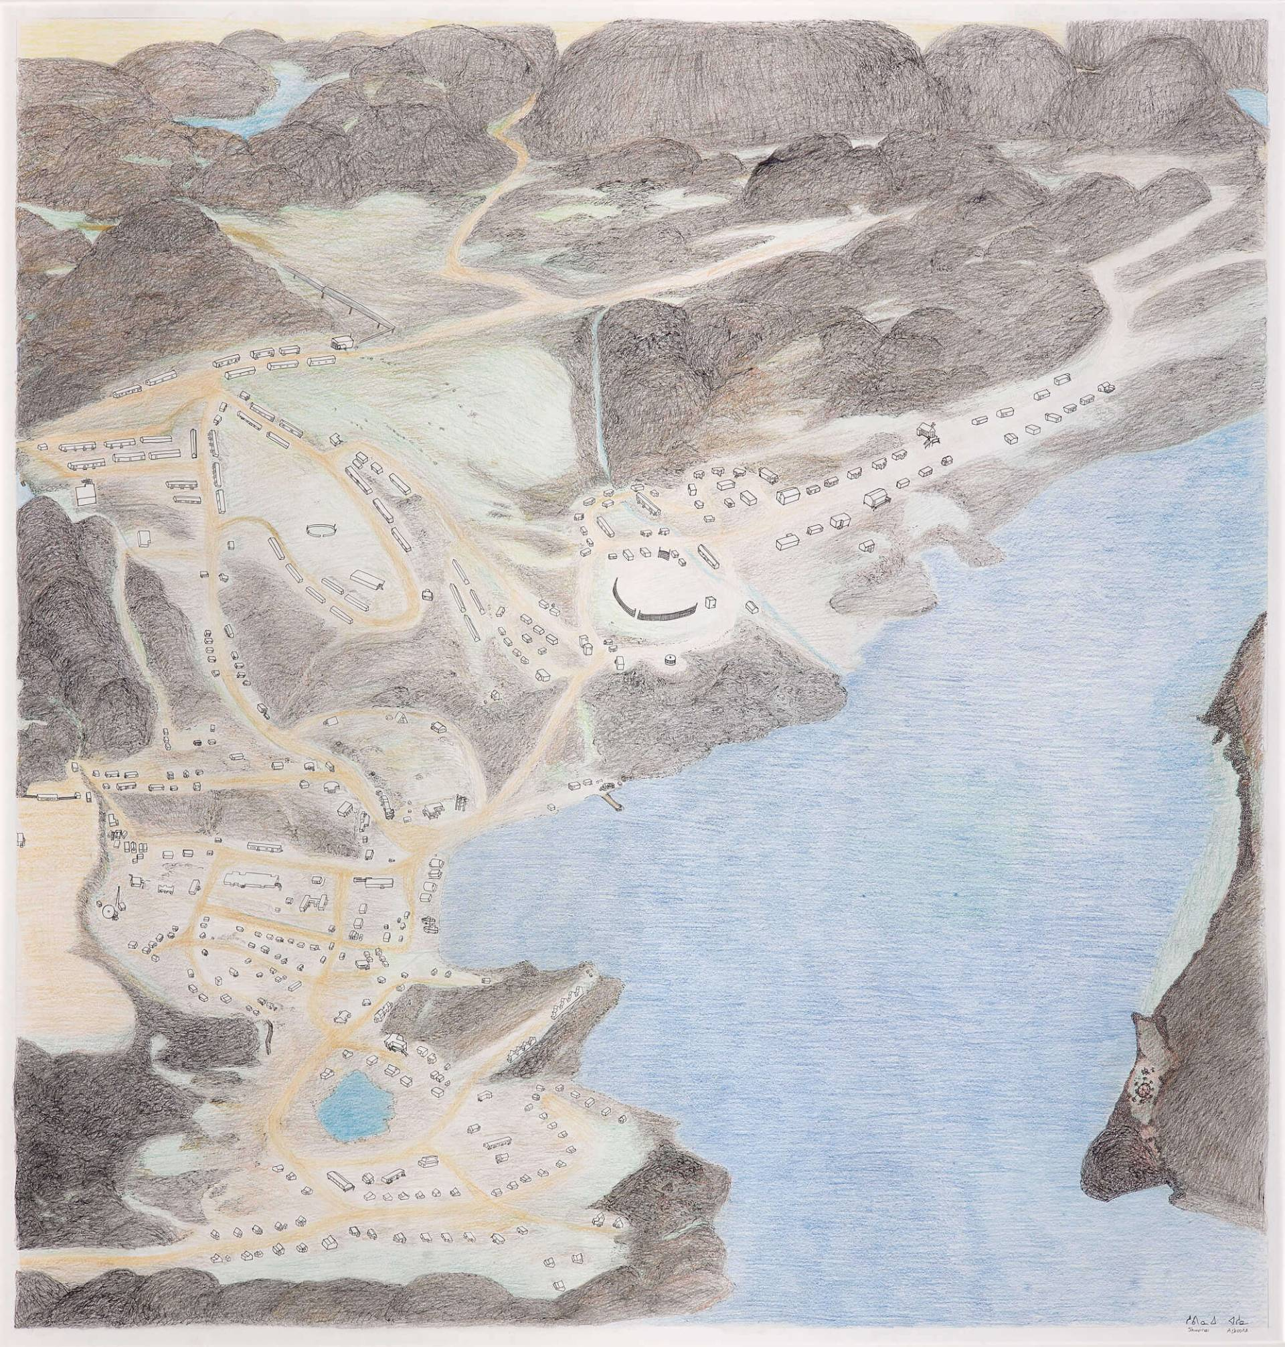
Learning Activity #2
Shuvinai Ashoona, Cape Dorset from Above, 2012. With this work Ashoona offers an aerial view of Kinngait.

Slide 26
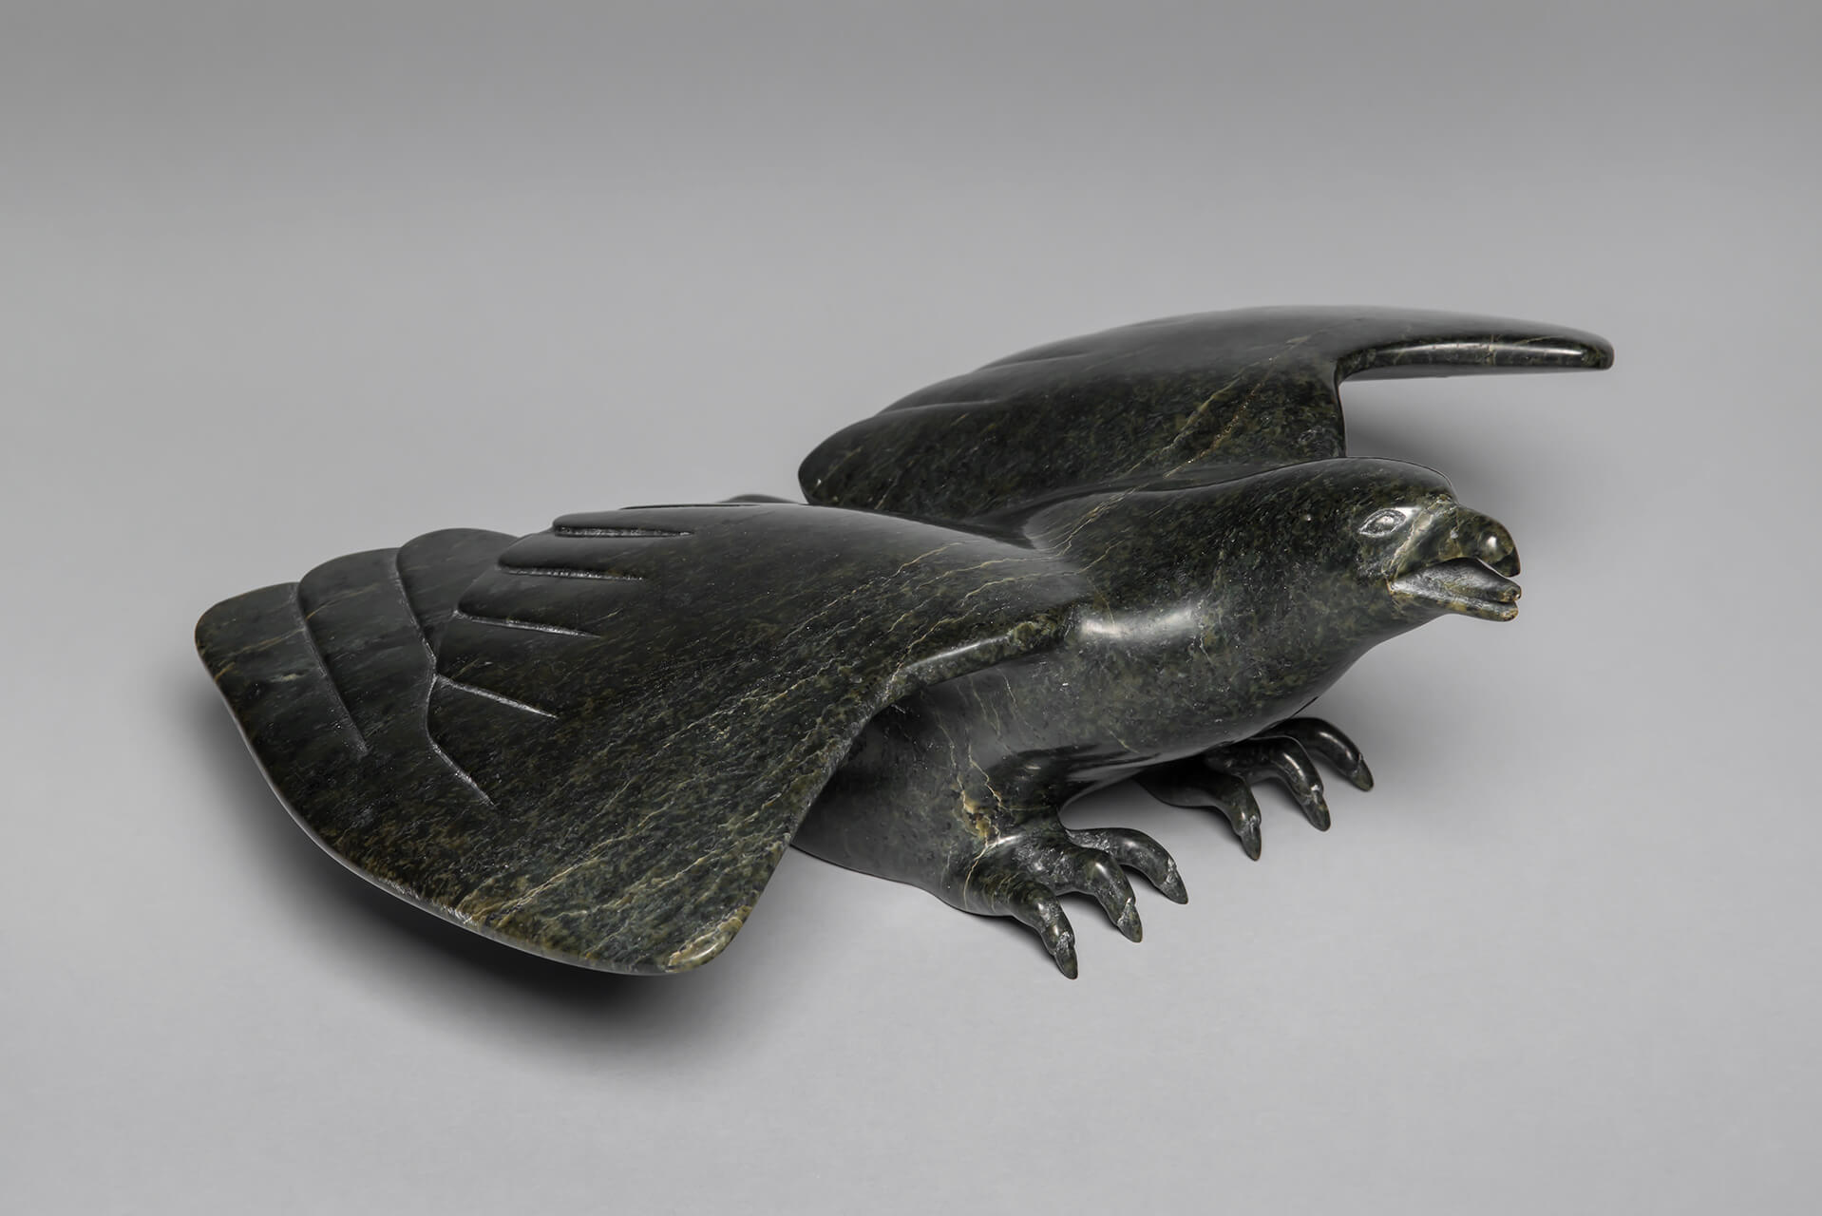
Learning Activity #2
Oviloo Tunnillie, Hawk Landed, c.1989. Tunnillie was known for exceptional detail, as can be seen in this hawk’s feathers and claws.

Slide 27
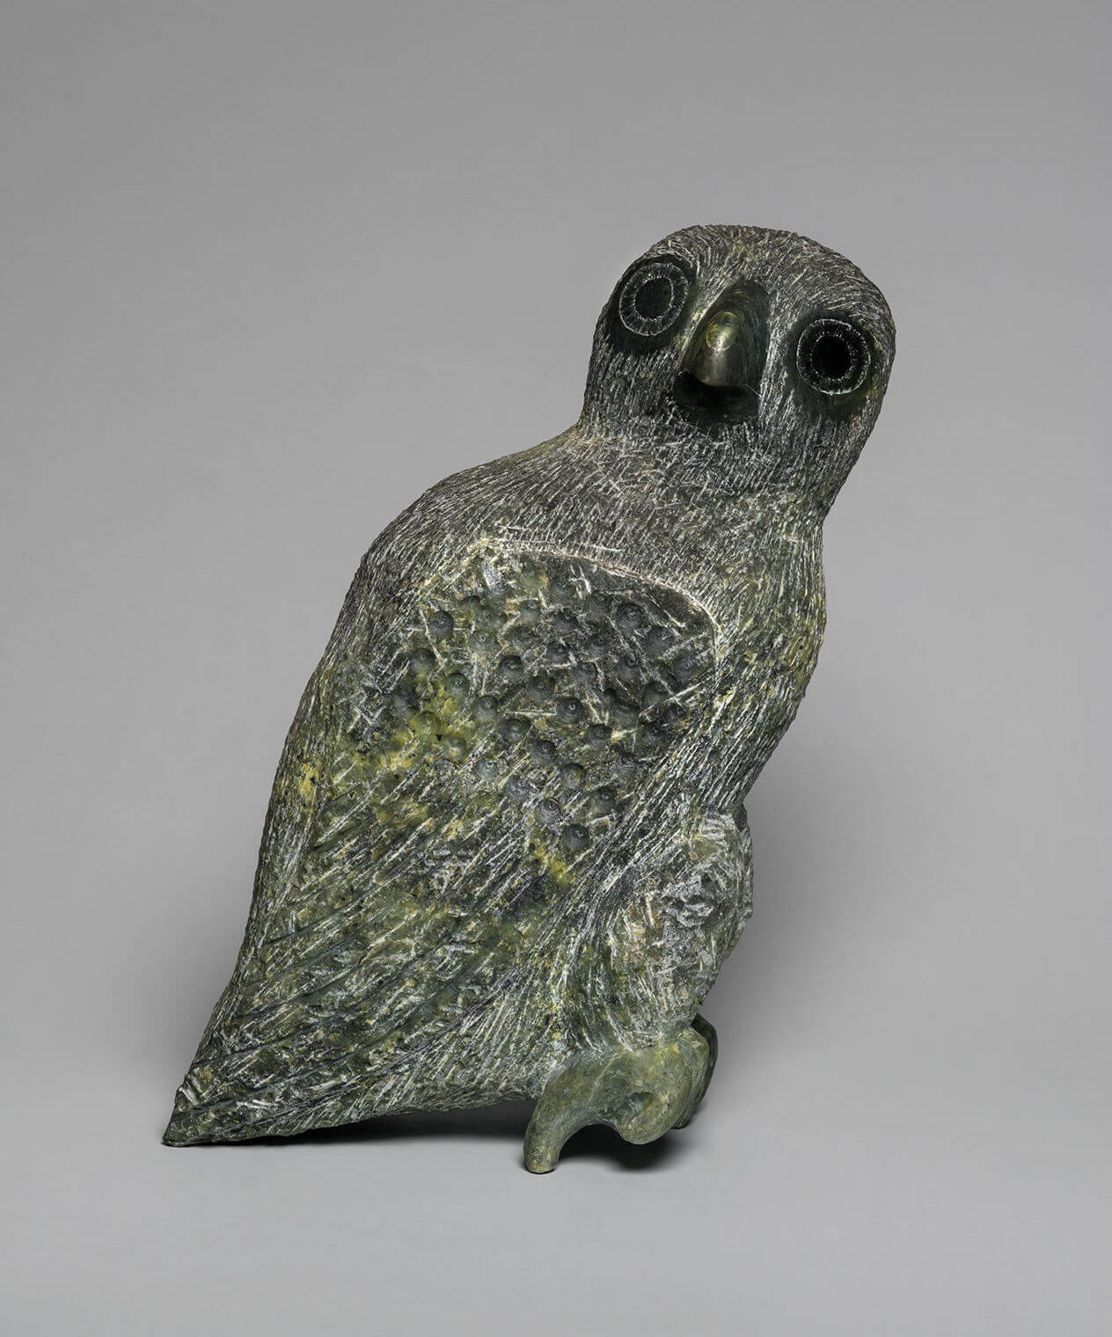
Learning Activity #2
Oviloo Tunnillie, Owl, 1974. For this work Tunnillie used an axe on the body and sandpaper to shape the feathers on the wings.

Slide 28
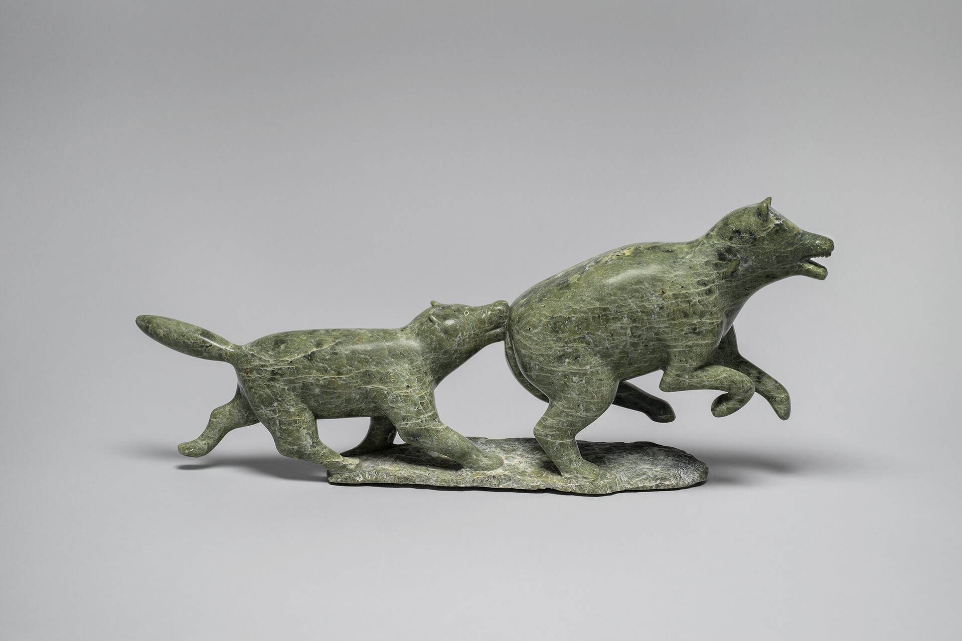
Learning Activity #2
Oviloo Tunnillie, Dog and Bear, 1977. This sculpture captures the determination of a dog hunting and a bear’s frantic effort to escape.

Slide 29
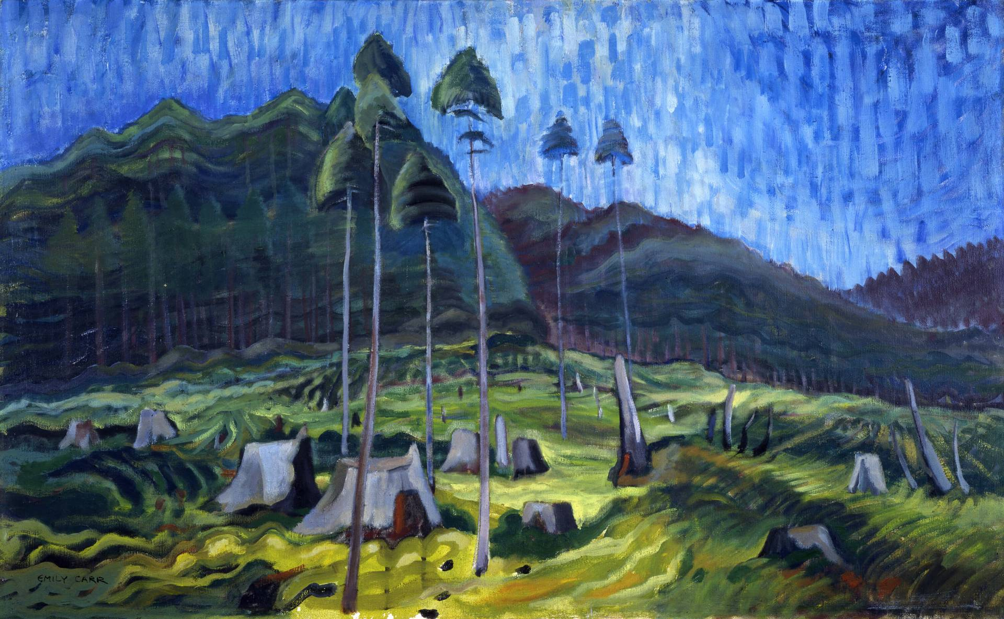
Culminating Task
Emily Carr, Odds and Ends, 1939. Carr was deeply moved by the sight of rotting tree stumps after clearcutting.

Slide 30
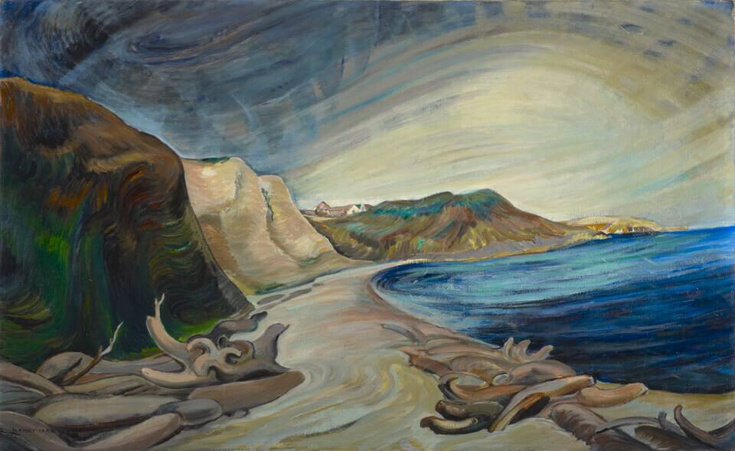
Culminating Task
Emily Carr, Shoreline, 1936. Carr experimented with using very thin paints to capture swirling rays of light.

Slide 31
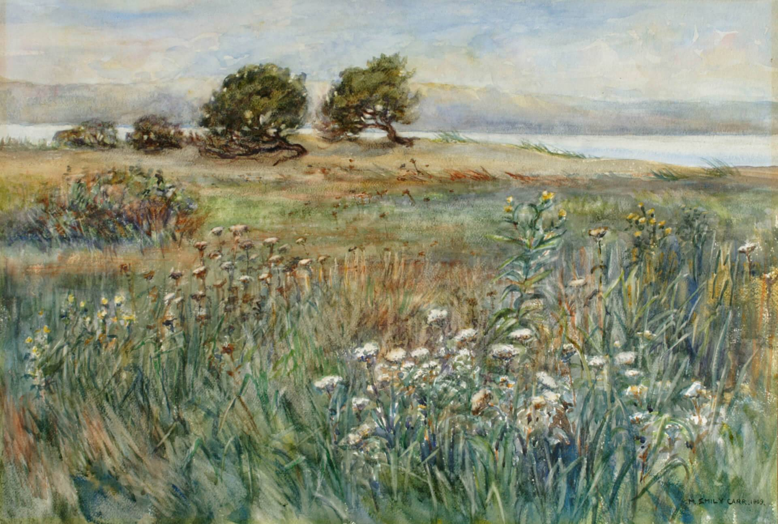
Culminating Task
Emily Carr, Beacon Hill Park, 1909. This early work represents a park near Carr’s childhood home.

Slide 32
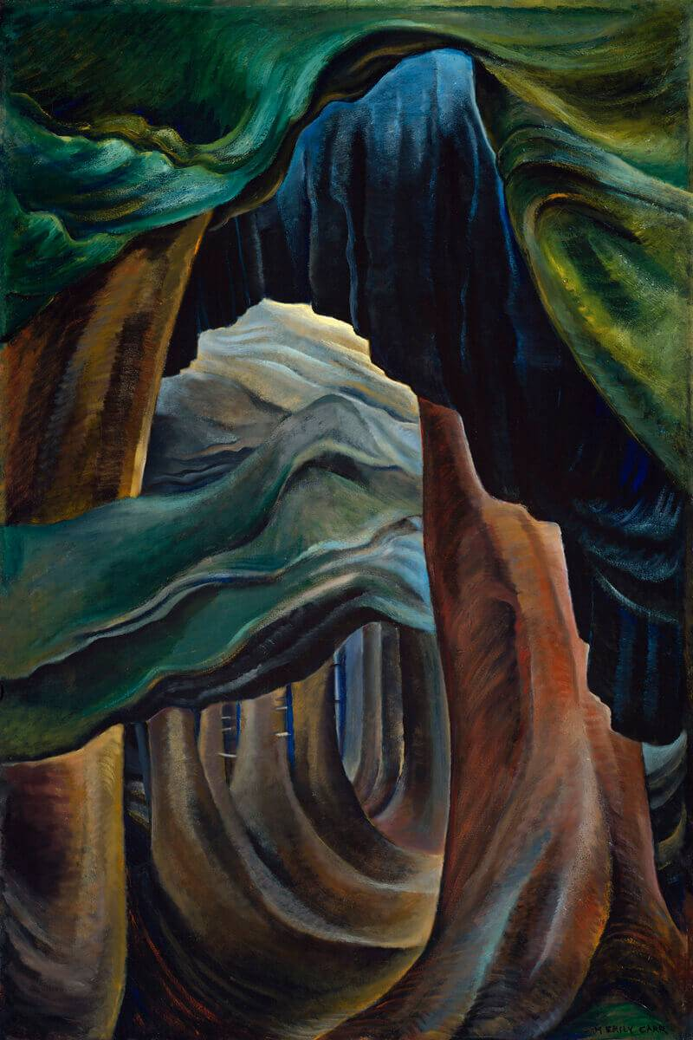
Culminating Task
Emily Carr, Forest, British Columbia, 1931–32. In this painting, the forest is illuminated from within.

Slide 33
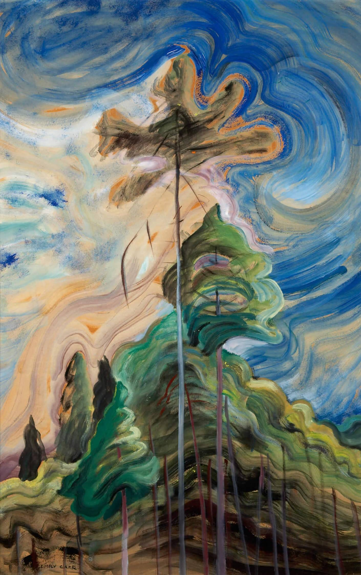
Culminating Task
Emily Carr, Sunshine and Tumult, 1938–39. The swirling blues of the sky suggest a joyous energy.

Slide 34
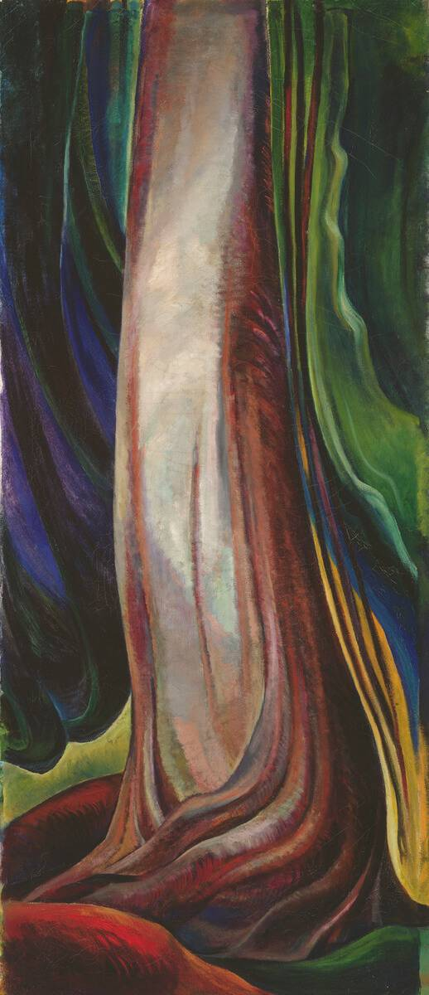
Culminating Task
Emily Carr, Tree Trunk, 1931. Carr’s explorations of trees and forests sometimes seem almost abstract.

Slide 35
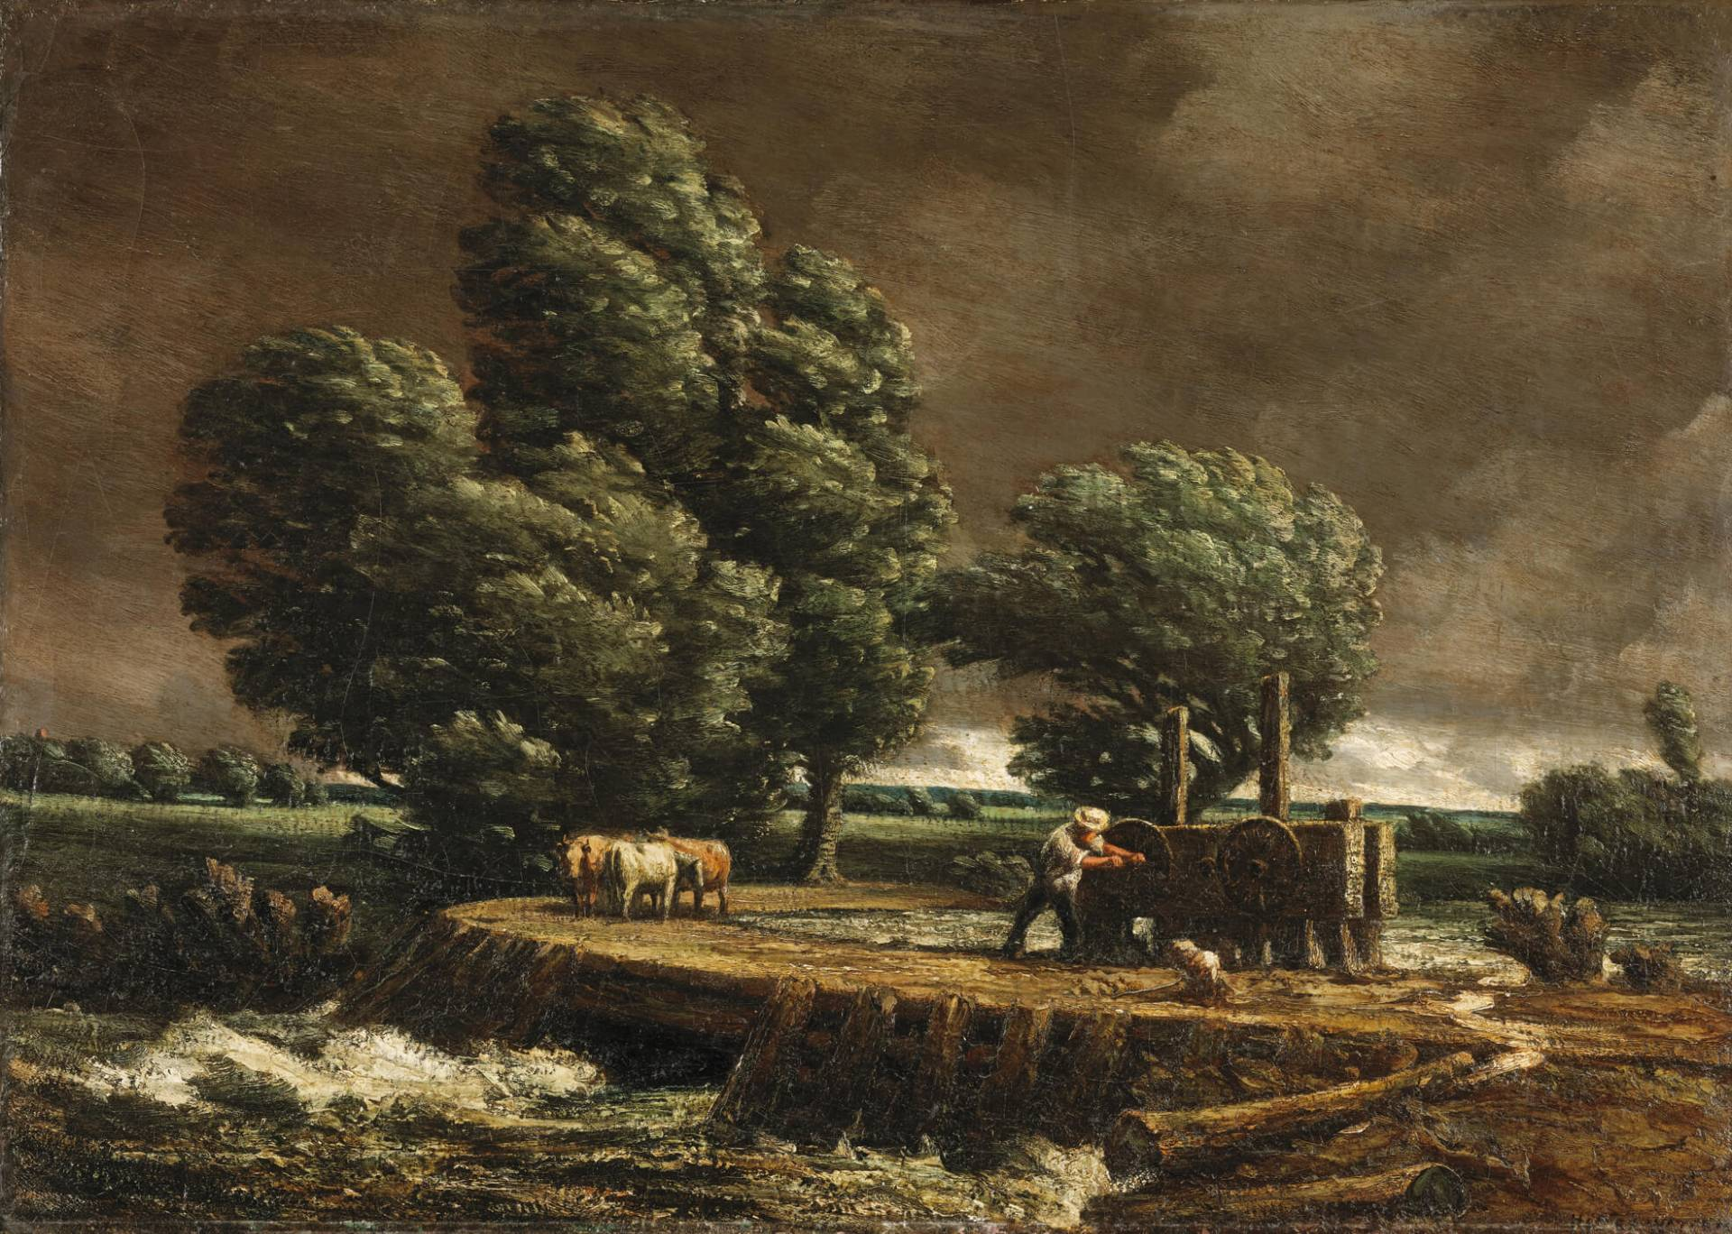
Culminating Task
Homer Watson, The Flood Gate, 1900–1. Watson was passionately interested in the landscape near his home in Doon, Ontario.

Slide 36
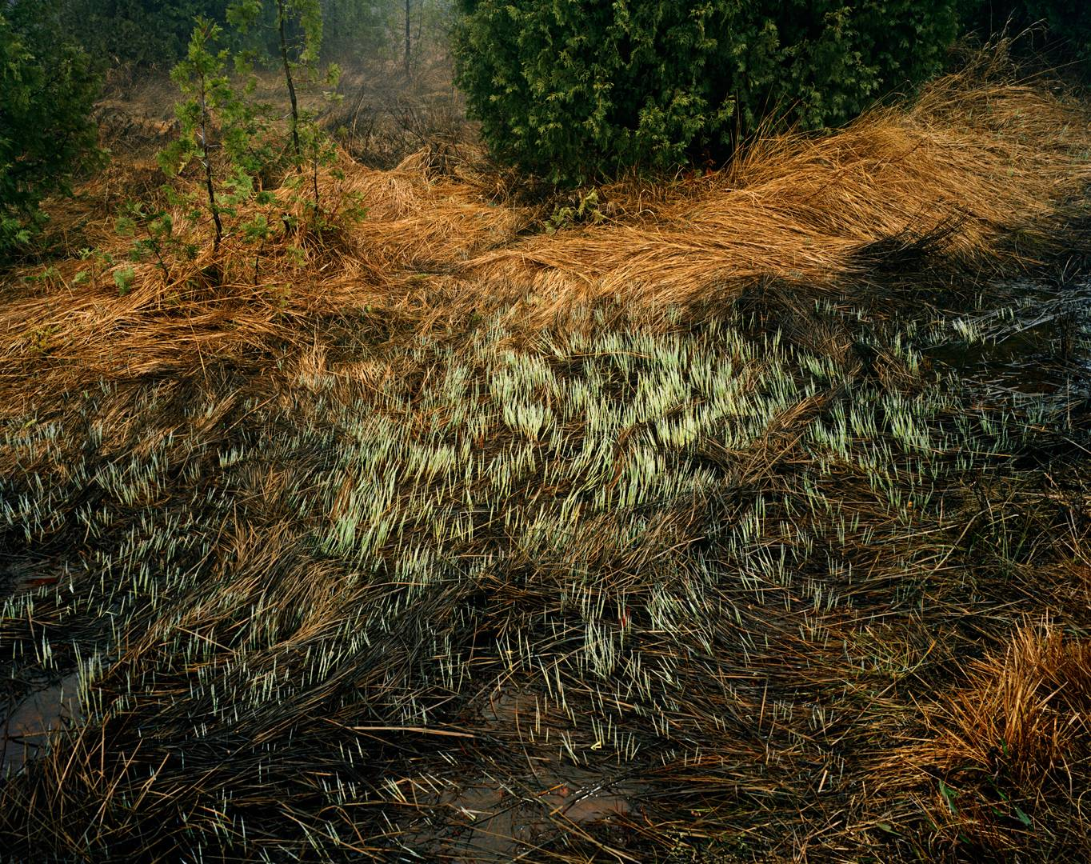
Culminating Task
Edward Burtynsky, Grasses, Bruce Peninsula, 1981. Burtynsky has long had an interest in the Ontario landscape, returning to it many times.

Slide 37
Culminating Task
Oviloo Tunnillie, Dog and Bear, 1977. This sculpture is made from serpentinite, a stone from the Arctic.

Slide 38
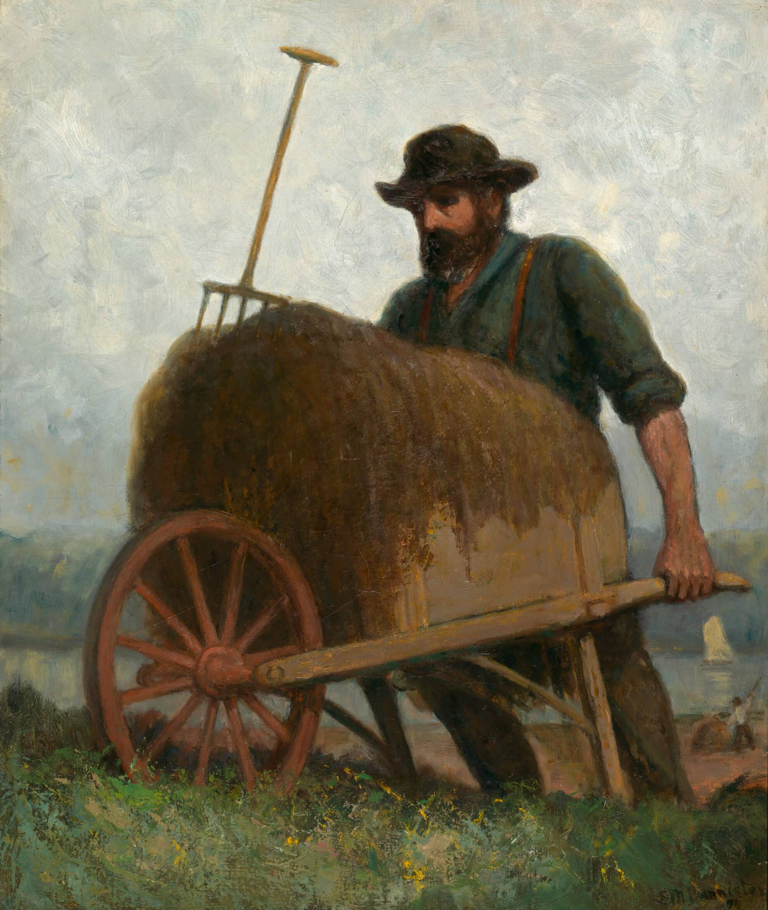
Culminating Task
Edward Mitchell Bannister, Seaweed Gatherers, c.1898. One of the most celebrated Black Canadian artists from the mid 1800s, Bannister became famous for his rural subjects.

Slide 39
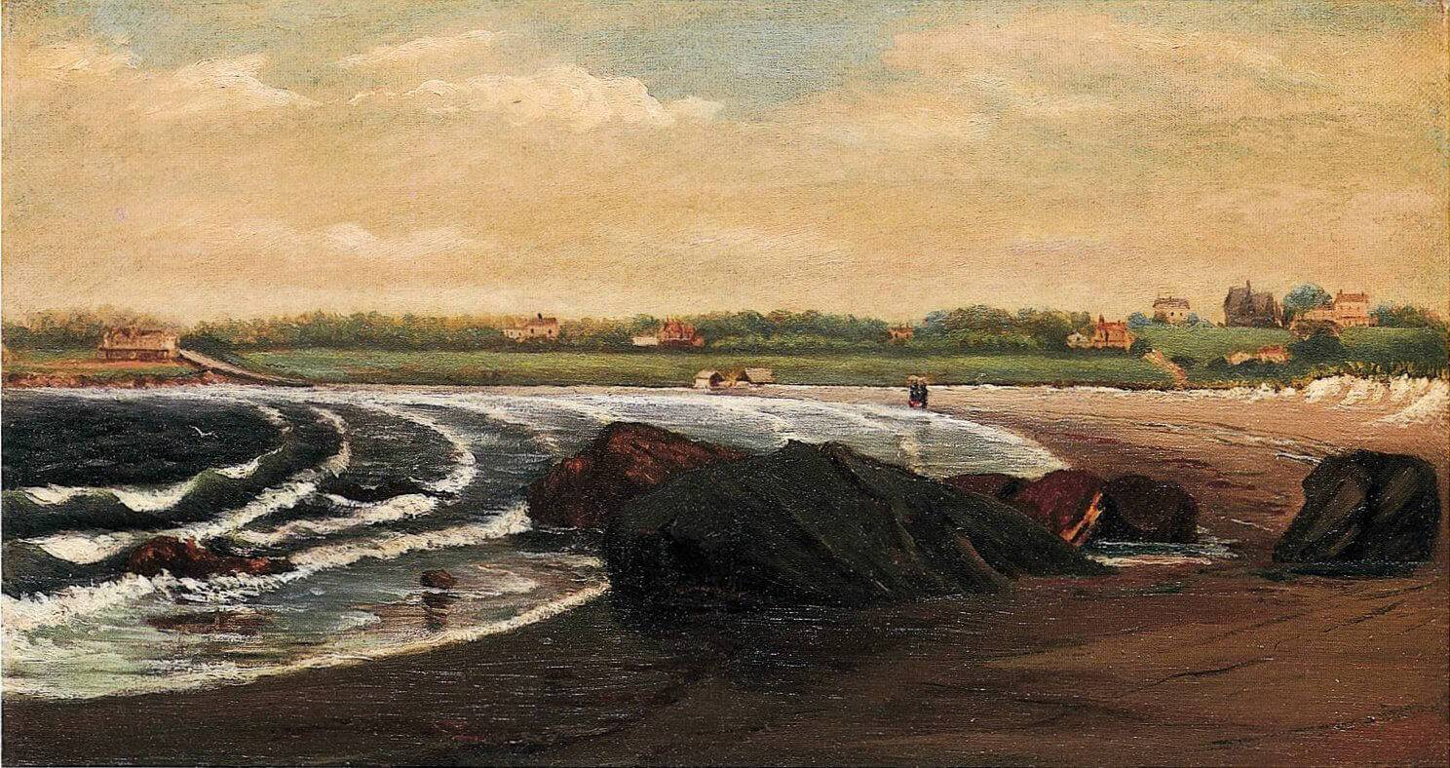
Culminating Task
Edward Mitchell Bannister, (Untitled) Rhode Island Seascape, c.1856. Originally from New Brunswick, Bannister moved to the United States as a young artist.

Slide 40
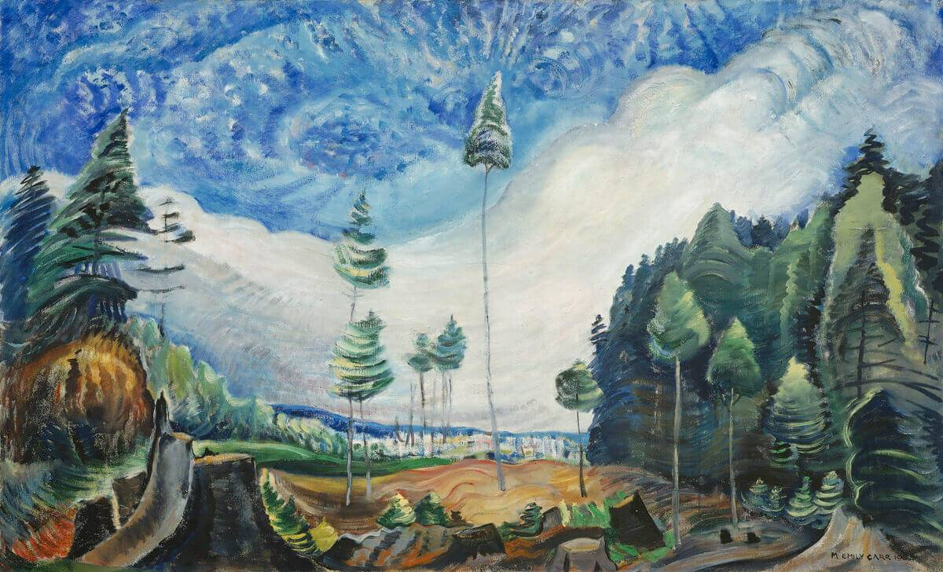
Emily Carr, Loggers’ Culls, 1935. Carr was deeply troubled by the effects of clearcutting and in her art she represented devastated landscapes.

Slide 41
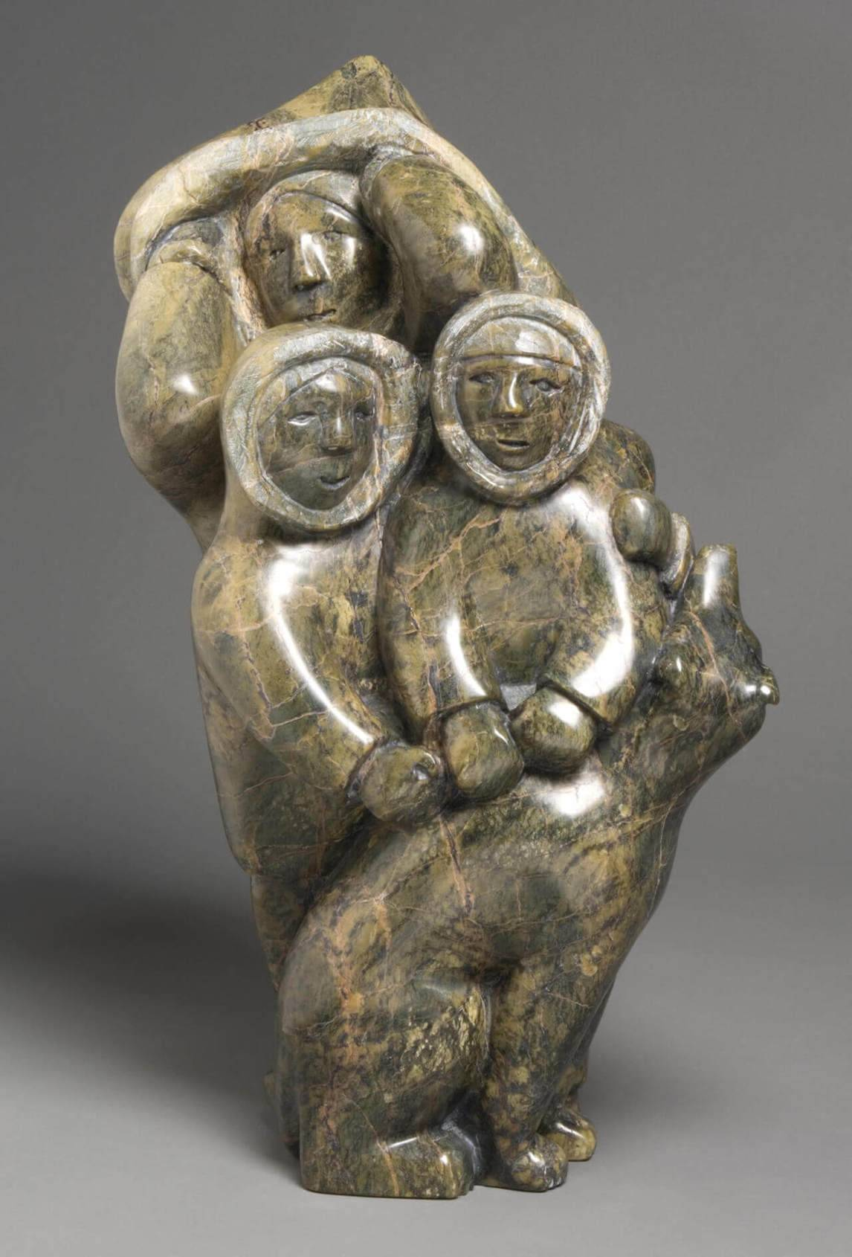
Oviloo Tunnillie, Family, 2006. This family sculpture includes a dog.

Slide 42
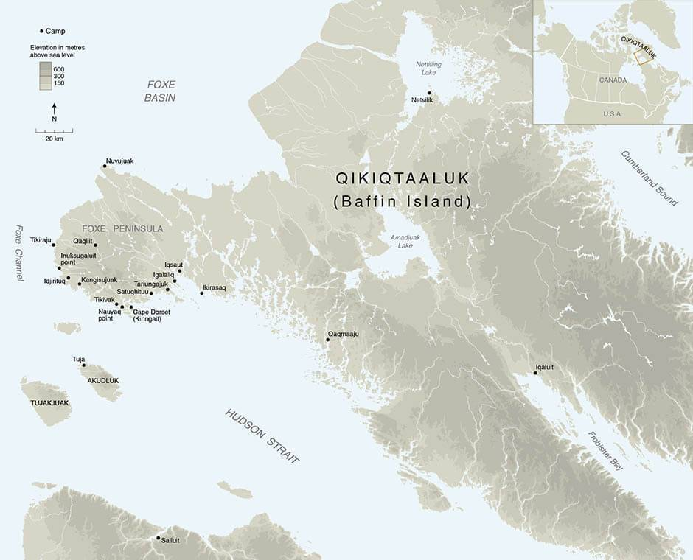
Map of Qikiqtaaluk (Baffin Island).

Slide 43
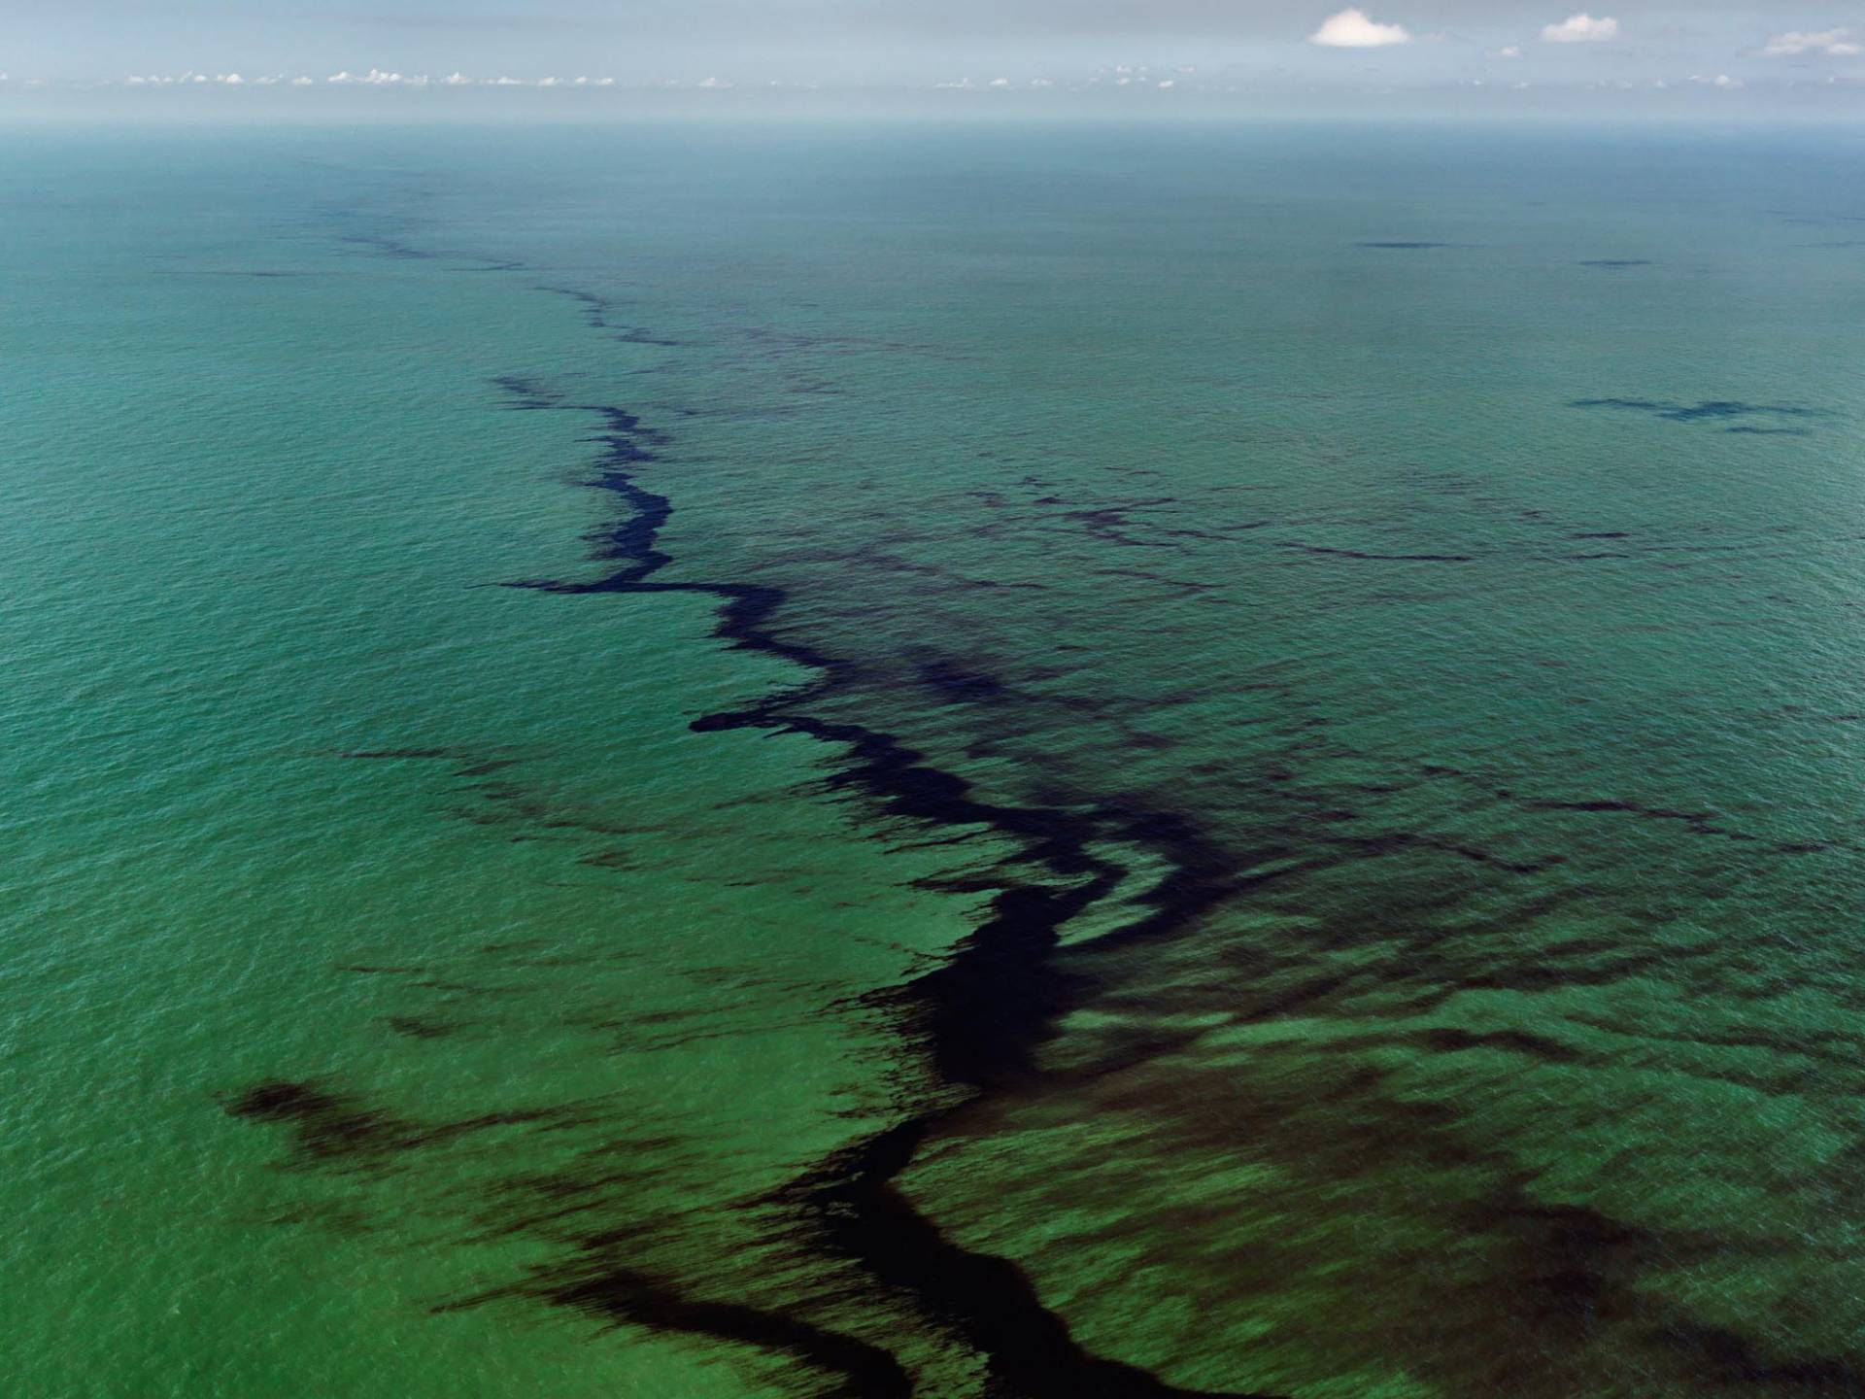
Edward Burtynsky, Oil Spill #10, Oil Slick at Riptide, Gulf of Mexico, June 24, 2010. Commenting on his interest in oil, Burtynsky notes that he has considered it “as both the source of energy that makes everything possible, and as a source of dread, for its ongoing endangerment of our habitat.”

